Slide 1

BC OIL AND GAS COMMISSION
MONTNEY DATA RESOURCES
For Researchers and Others
Inquiries: Reservoir@bcogc.ca or OGC.ResourceConservation@bcogc.ca
January 2021

Slide 2



Main Sections
What is the BC Oil and Gas Commission?
Montney Geology
Hydraulic Fracturing Activity in B.C.
Induced Seismicity in B.C.
Regulations and Public Data
Commission Research Priorities
Why we collect data.
Public well data & well files – reservoir pressure data, DFITs, flow tests and production, well logs, core, fluid analysis.
eLibrary, eSubmissions, and FracFocus.
Well data requests: “How To”.
2

Slide 3
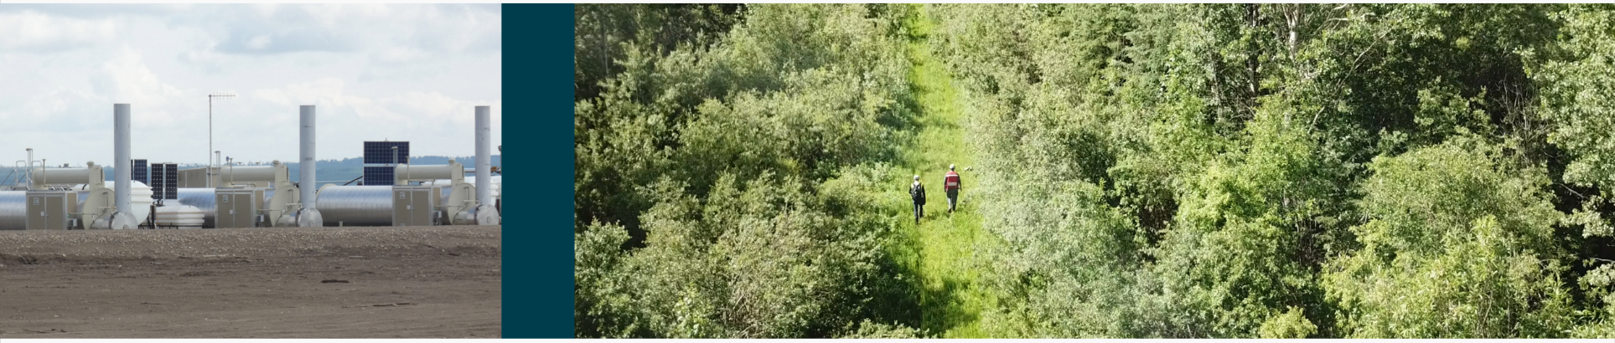
1. What is the BC Oil and Gas Commission (Commission)?
OUR ROLE AS REGULATOR: We oversee activities from exploration and development, to pipeline transportation and reclamation. Our role has recently expanded to include refineries, value added gas and liquids manufacturing processes and aspects of geothermal power.
3
Notes:
Who is the BC Oil and Gas Commission?
Established in 1998, we’re the single-window regulatory agency responsible for overseeing oil and gas operations, refineries, and geothermal development in British Columbia. Companies looking to explore, develop, produce and market oil and gas resources in B.C. must apply to the Commission.
The Commission is self-funded through the application of industry fees and levies. We are accountable to the provincial legislature and the public through the Ministry of Energy, Mines and Low Carbon Innovation.
We have a pure regulatory role:
We don’t develop legislation or associated policy - except technical regulations.
We don’t issue mineral tenures or set / administer royalties.
We have a Board of Directors who approve technical regulations.
The Oil and Gas Activities Act (OGAA) is our enabling statute, and while our regulatory framework is stable, it’s not static. We acknowledge and incorporate industry innovations where possible, allowing us to continually improve.
A full list of regulations and Acts through which we operate is available on our website at: https://www.bcogc.ca/how-we-regulate/legislative-framework/

Slide 4
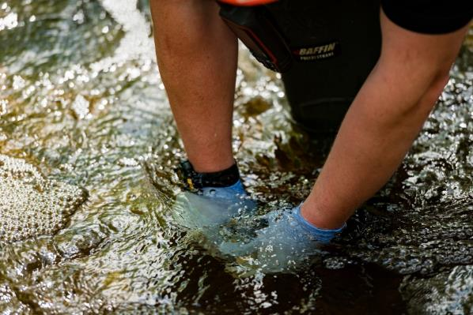
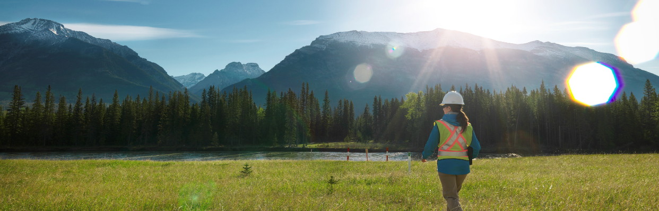
Section 1. Who is the Commission?
Our Team
Environmental Stewards Natural Resource Officers First Nations Liaisons
Hydrologists Geologists Heritage Conservation Officers
Reservoir Engineers Emergency Management Officers Air Specialists
4
Notes:
Our Team is made up of over 275 dedicated professionals, including experts in air, water, land and subsurface resources.
Our team makes decisions on proposed oil, gas and geothermal activities. When making these decisions, we’re charged with protecting public and environmental safety, while balancing a broad range of environmental, economic, and social considerations.
From exploration through to final reclamation, we work closely with communities and land owners, and confirm industry compliance with provincial legislation.
We also ensure there are close working relationships with Indigenous peoples, engaging with them (and industry) on proposed regulations and significant amendments.

Slide 5
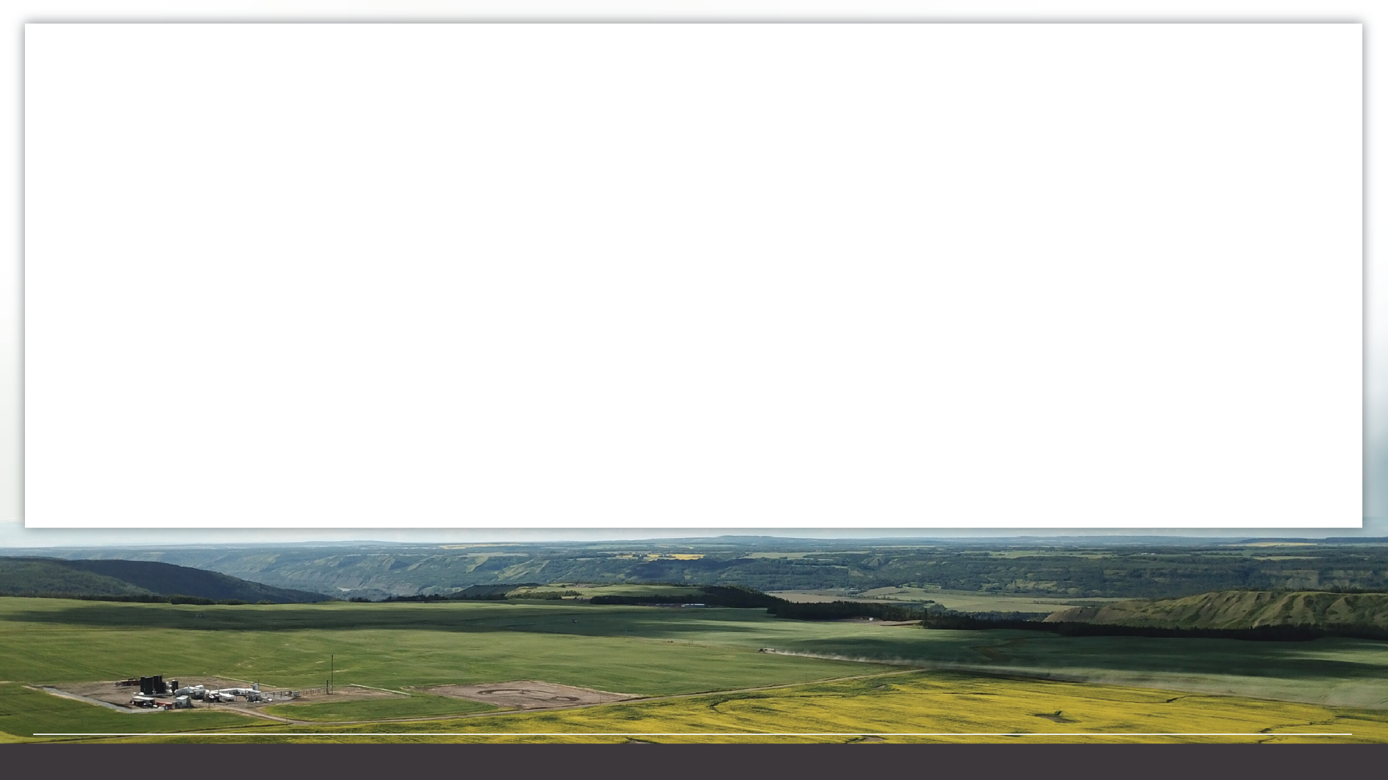
Section 1. Who is the Commission?
Our Vision
Our Mission
Our Mandate
Safe and responsible energy resource development for British Columbia.
Protect public safety.
Safeguard the environment.
Respecting those individuals and communities who are affected.
Balances a broad range of environmental, economic and social considerations and includes maximizing recovery of the resource, for the benefit of the province.
Our Values
RESPECT INTEGRITY TRANSPARENCY INNOVATION RESPONSIVENESS
5
Notes:
We do our best to integrate our Vision, Mission and Values into our regulatory work.
We do this by:
Coordinating regulatory processes with other agencies.
Being transparent through sharing information.
Being responsible by establishing and maintaining a predictable process.
Maintaining integrity and credibility through action.

Slide 6
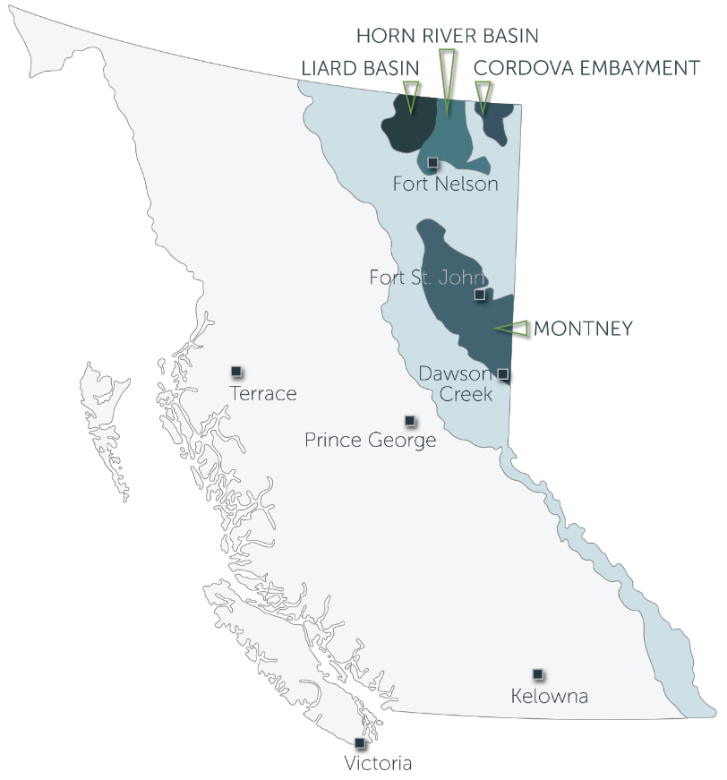
Section 1. Who is the Commission?
Where We Are
We can be found across the province in seven locations - from Fort Nelson all the way down to Kelowna and Victoria.
6
Notes:
The Commission’s workforce operates out of seven locations:
Fort Nelson
Fort St. John
Dawson Creek
Terrace
Prince George
Kelowna
Victoria
The largest number of employees are concentrated in Fort St. John, the heart of oil and gas activity in the province.
The offices in Fort Nelson and Dawson Creek ensure the Commission’s presence near the Montney gas play.

Slide 7

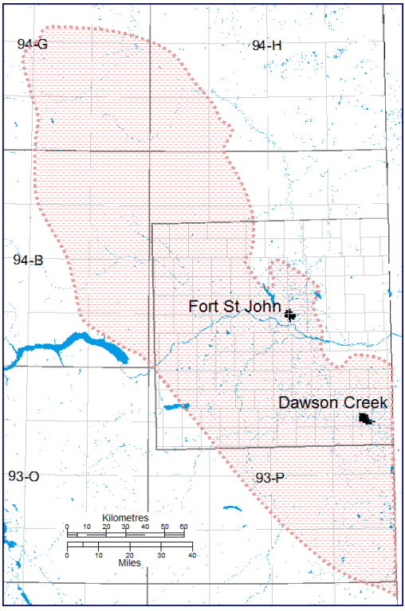
2. Montney Geology
Background on Unconventional Gas in the Montney
Prior to 2005, development of gas in the Montney unconventional play trend area was restricted to vertical drilling for poor quality conventional fine grained sandstone reservoirs. In July 2005 the first attempt to employ multistage hydraulic fracturing in a Montney horizontal well occurred near Dawson Creek. Initial production commenced from this well at rates four to five times higher than a vertical well in the same target horizon. This was quickly followed by other successful horizontal wells. Subsequent drilling and coincident geologic investigation eventually defined a regional unconventional resource play trend of approximately 26,000 square kilometres (km²).
7
Notes:
At the end of 2020 the unconventional Montney play trend contributes greater than 85 per cent of B.C.’s total raw natural production and accounts for almost all current development drilling activity.

Slide 8
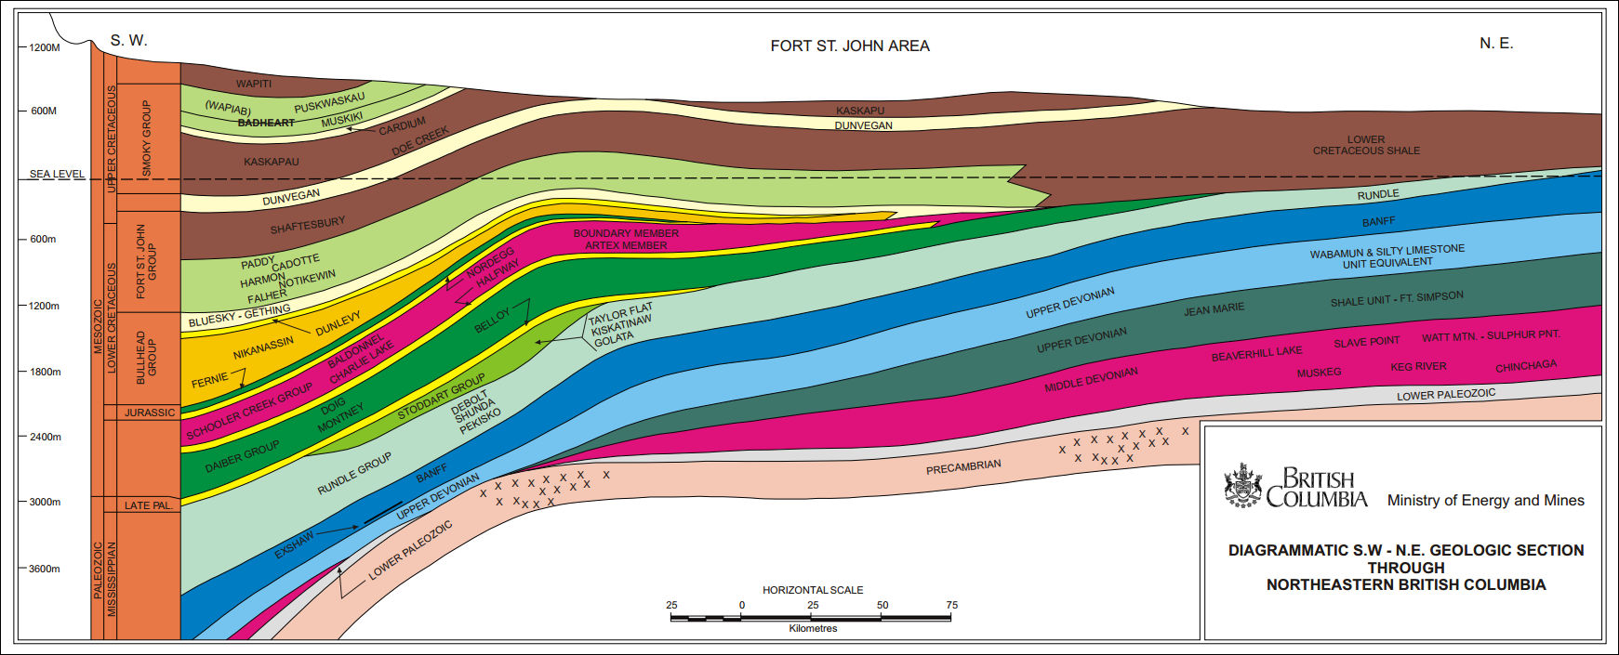
Section 2. Montney Geology
Stratigraphic Cross-Section Southwest to Northeast
SW
NE
Montney
8
Notes:
The unconventional Montney is a thick (250m-300m) regionally pervasive high pressure “deep basin” type resource that has been developed with HZ wells at depths ranging from 1,400m – 3,800m.

Slide 9
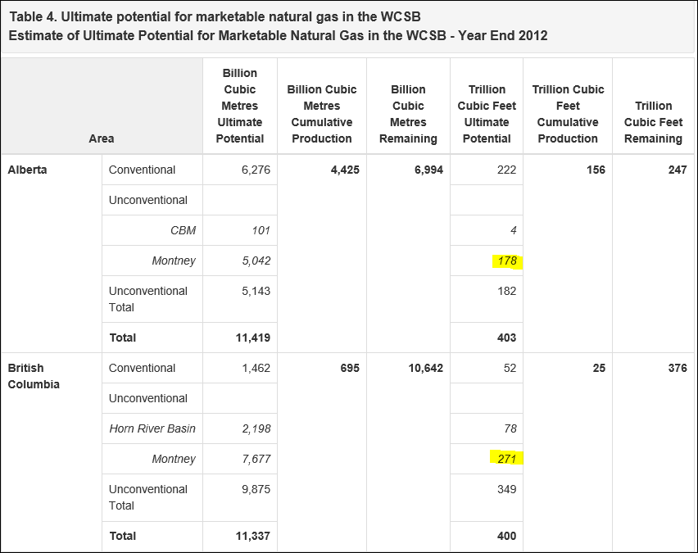
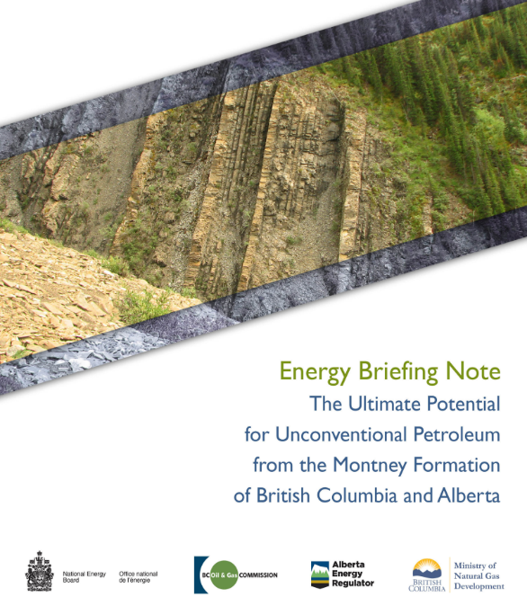
Section 2. Montney Geology
Montney Resource Assessment
To view this Energy Briefing Note, please refer to: https://www.cer-rec.gc.ca/nrg/sttstc/ntrlgs/rprt/ltmtptntlmntnyfrmtn2013/ltmtptntlmntnyfrmtn2013-eng.html#s4
9
Notes:
Due to the Montney’s thickness, high pressure and large prospective area the Montney represents a very significant natural gas, natural gas liquids and condensate resource. In 2012, the Canada Energy Regulator (CER) and BC Oil and Gas Commission estimated the B.C. share of marketable resource base to be 271 trillion cubic feet (TCF) of natural gas. Subsequent independent estimates have ranged to greater than 400 TCF. For reference, in 2020 B.C. produced approximately 2 TCF for the calendar year.
To view this Energy Briefing Note, please refer to: https://www.cer-rec.gc.ca/nrg/sttstc/ntrlgs/rprt/ltmtptntlmntnyfrmtn2013/ltmtptntlmntnyfrmtn2013-eng.html#s4

Slide 10
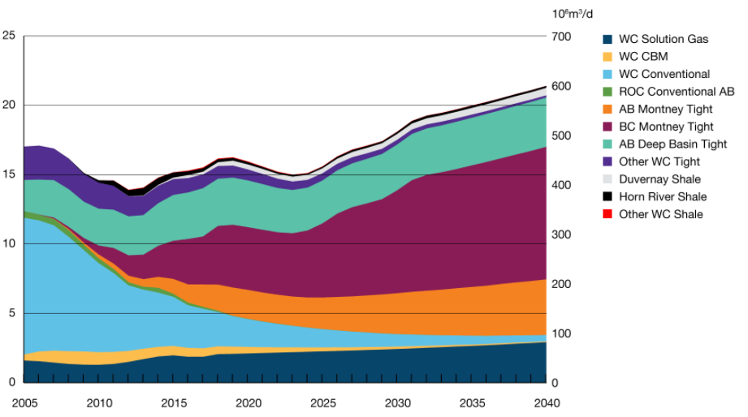
Section 2. Montney Geology
Natural gas production by type increases led by production from the Montney Formation
To view this production graph, please refer to:
https://www.cer-rec.gc.ca/nrg/ntgrtd/ftr/2019/rslts/index-eng.html#natural-gas
10
Notes:
Conventional gas supply areas are in significant decline and many other unconventional plays like the Horn River and Liard Basin are expensive to operate in. With its huge resource base and competitive supply cost economics the Montney is forecast to be a significant driver for natural gas supply growth for the next several decades as well as the main supply for the new LNG industry feedstock.
CER Canada’s Energy Future - Growth in the B.C. Montney is projected to occur through to 2040.
To view this production graph, please refer to: https://www.cer-rec.gc.ca/nrg/ntgrtd/ftr/2019/rslts/index-eng.html#natural-gas

Slide 11
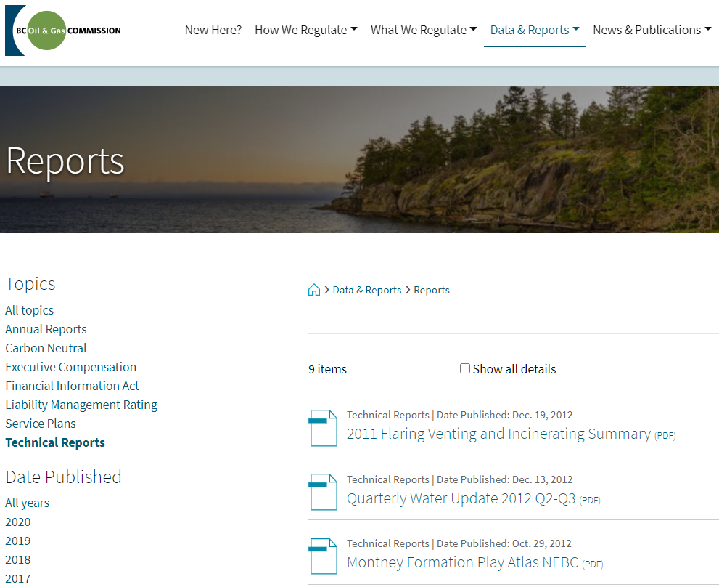
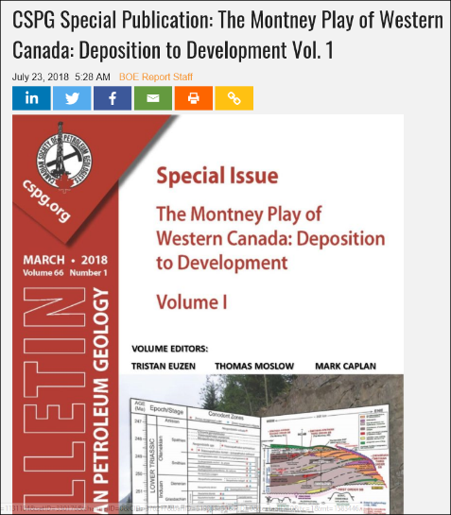
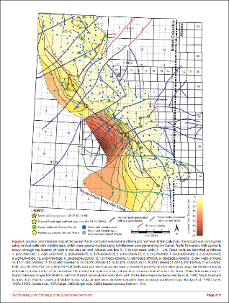
Section 2. Montney Geology
Publicly Available Montney Resources
CSPG WCSB Geological Atlas and Montney Bulletin
Check out the Montney Atlas on the
Data & Reports webpage at www.bcogc.ca
11
Notes:
The Montney is the most significant unconventional play in western Canada and has been the subject new research and publications. The following slides offer a general overview of the Montney ‘s geologic setting.

Slide 12
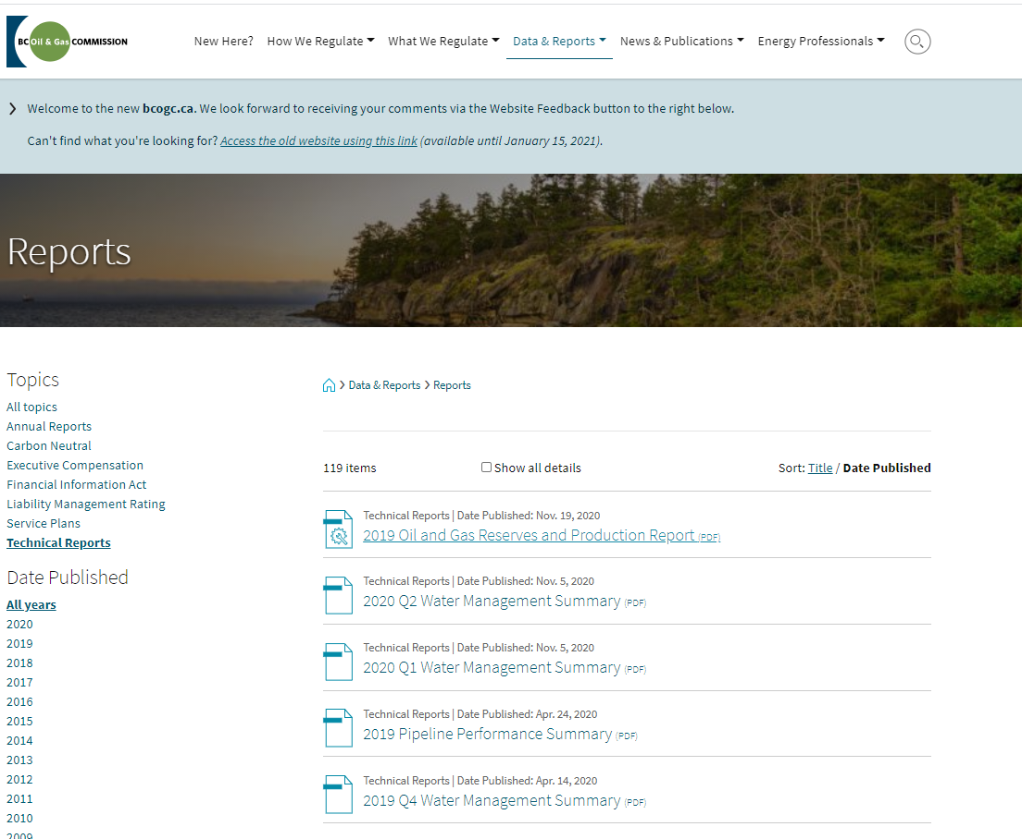
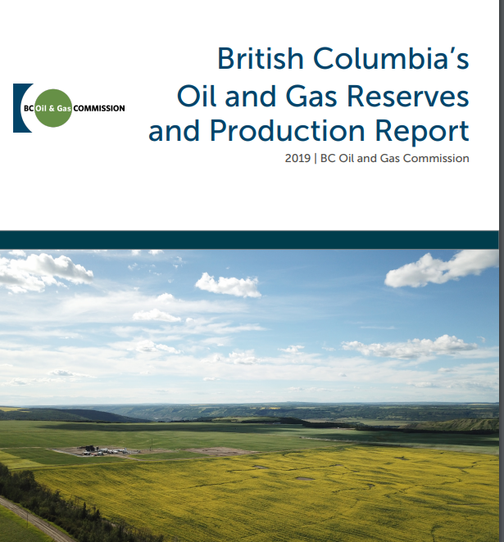
Section 2. Montney Geology
Publicly Available Montney Resources
Check out the large Montney section of the Oil and Gas Reserves Report on the BCOGC webpage at https://www.bcogc.ca/data-reports/reports/
12
Notes:
The Montney is the most significant unconventional play in western Canada and has been the subject new research and publications. The following slides offer a general overview of the Montney ‘s geologic setting.

Slide 13
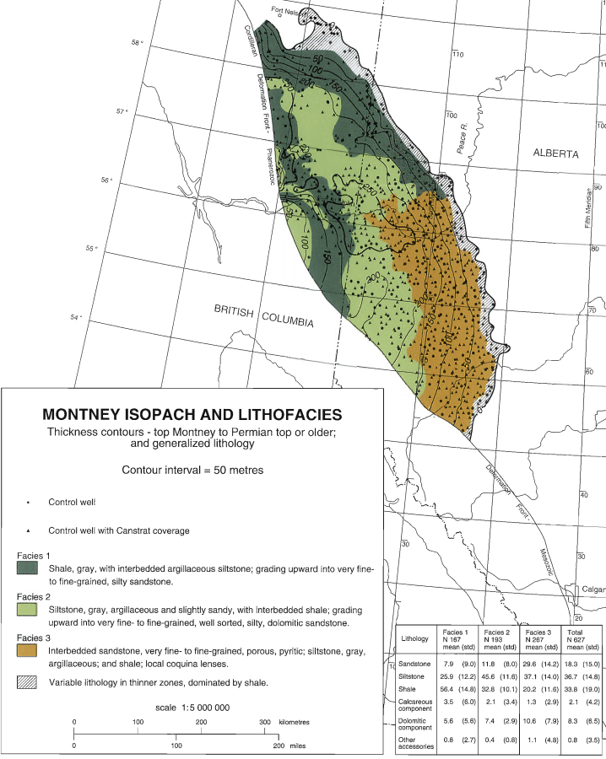
Section 2. Montney Geology
Lower Triassic Montney Formation
Aerially extensive.
Covers approx. 130,000 km².
Ranges from 100 m to 300 m thick.
To view this Montney
isopach map, please refer to:
https://www.cspg.org/common/Uploaded%20files/pdfs/documents/publications/atlas/geological/atlas_16_triassic.pdf
13
Notes:
The Lower Triassic Montney Formation is aerially extensive, covering approximately 130,000 km². It is also thick, typically ranging from 100 m to 300 m, though thins to zero at its eastern and northeastern edges while increasing to over 300 m on its western side before it begins outcropping in the Rocky Mountains. Most of the formation consists of siltstone containing small amounts of sandstone that originally collected on the bottom of a deep sea, whereas more porous sandstones and shell beds were deposited in shallow water environments to the east. The depth of the formation also increases from northeast to southwest, generally along with increasing reservoir pressures and decreasing natural gas liquid (NGL) and oil content. Thus, reservoir characteristics vary widely across the formation.
For a more detailed description of Montney geology in Alberta, please see Summary of Alberta’s Shale-and Siltstone-Hosted Hydrocarbon Resource Potential as well as the forthcoming assessment of the lowermost Doig siltstone’s resource potential. For more details on Montney geology in British Columbia, please see the Montney Formation Play Atlas NEBC.^{[1]} Other details about the Montney Formation are available in Chapter 16 of the Geological Atlas of the Western Canada Sedimentary Basin.^{[2]}
[1] https://www.bcogc.ca/files/reports/Technical-Reports/montney-format-play-atlas-nebc.pdf
[2] https://www.cspg.org/common/Uploaded%20files/pdfs/documents/publications/atlas/geological/atlas_16_triassic.pdf

Slide 14
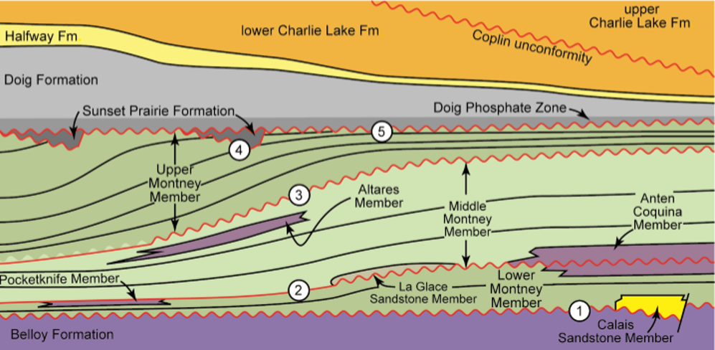
Section 2. Montney Geology
West
(British Columbia)
Commission Montney Zones
East (Alberta)
UPPER
U MIDDLE
L MIDDLE
LOWER
14
Notes:
Schematic approximately west-east cross-section showing Montney stratigraphy, central Alberta to B.C. Note the intra and extraformational unconformities that separate the Lower Montney, Middle Montney, and Upper Montney members (numbers 1-5).
The basal Montney contact (1) is unconformable throughout most of the basin but may be conformable in the western subsurface and outcrop belt in some areas.
The lowers and oldest intraformational unconformity (2) approximates the Dienerian-Smithian (=Induan-Olenekian boundary).
A second, younger mid-Montney unconformity occurs at approx. the Smithian-Spathian boundary (mid Olenekian).
The upper Montney contact is unconformable with overlying Middle Triassic strata of either the Sunset Prairie Formation (Furlong et al., 2018a and b, this issue) or the Doig phosphate zone (unconformities 4 and 5).
(Figure 2, page 96, J.P. Zonnveld and T.F. Moslow)

Slide 15

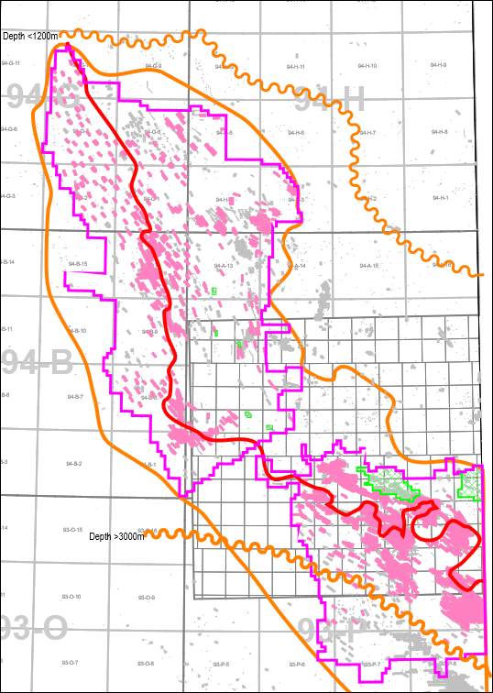
Section 2. Montney Geology
Montney Play Trend
Development preferentially occurs in “wetter” areas (those with high NGL/gas condensate content above dry gas line) *LNG related development may not be as influenced by CGR.
Investigative drilling is extending the updip edge into shallower lower pressure regimes.
Over 3,000 m and below 1,200 m depth to top Montney.
Defined oil legs in Heritage but most high liquid content areas are defined as condensate.
15

Slide 16

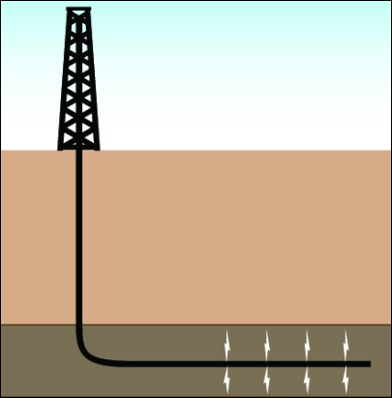
Section 2. Montney Geology
Horizontal (HZ) drilling data
basics
KB (Kelly Bushing)
Ground level (~ Casing Flange)
Sea level
True Vertical Depth TVD KB Depth to end of well in a straight line.
Subsea (m)
TD (Total Depth)
o
HZ @80
Measured Depth MD
Depth measured along well bore path
Lateral Length
16
Notes:
Detailed data is collected, submitted and made public by the Commission for every well drilled in the province. Drilling data is available that accurately records the exact location and drill path for every HZ well. All measurements along the well bore are referenced from the drilling rig floor or Kelly Bushing (KB). As the well is drilled it is surveyed at regular intervals and critical trajectory elements are recorded for azimuth inclination measured depth and true vertical depth. Well bore survey is available for every well and critical for understanding and relating well target and completion events.

Slide 17
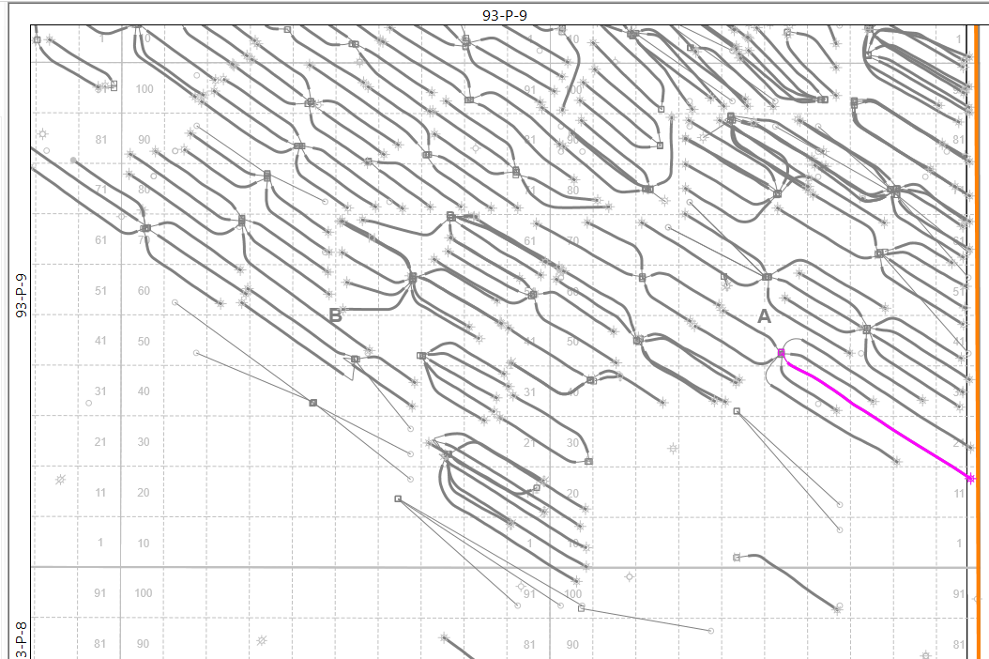
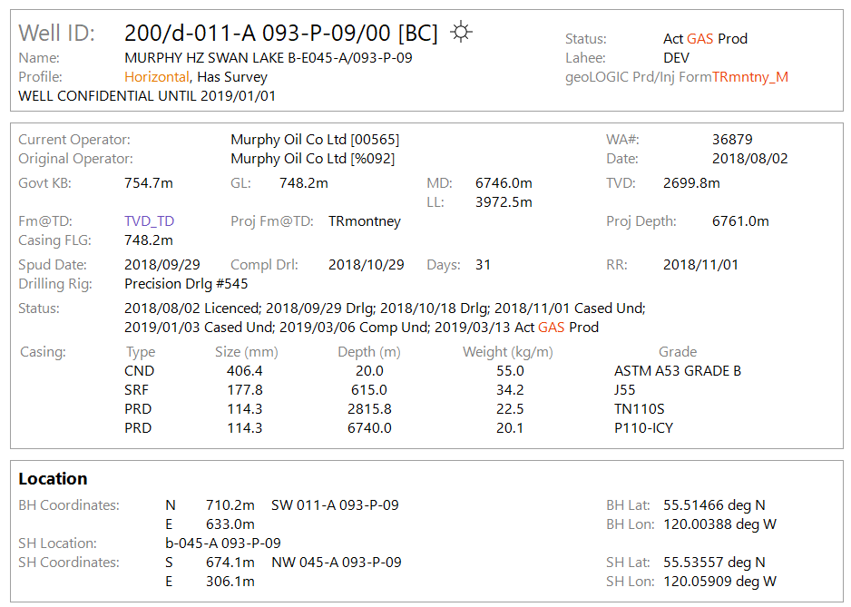
Section 2. Montney Geology
17
Notes:
In the example commercial Data vendors collect and display all relevant well data in a well “ticket”. The purple box highlights where critical HZ well data; KB GL, MD TVD Lateral length are displayed.

Slide 18
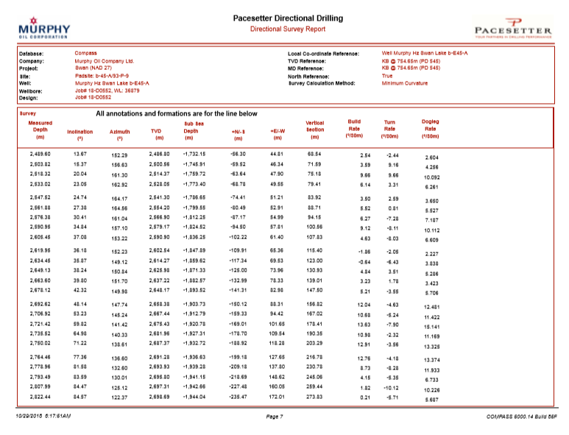
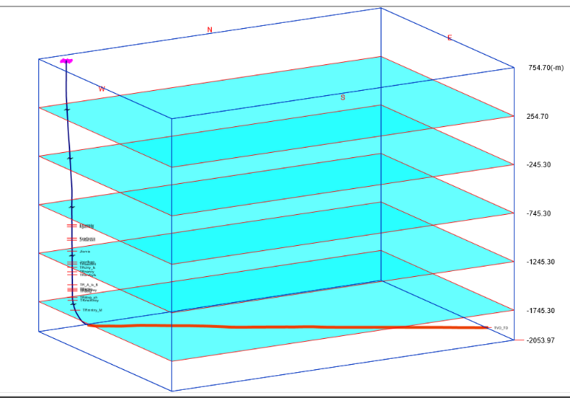
Section 2. Montney Geology
18
Notes:
This example is a drilling survey which is used to precisely describe well trajectory and locate well events.

Slide 19
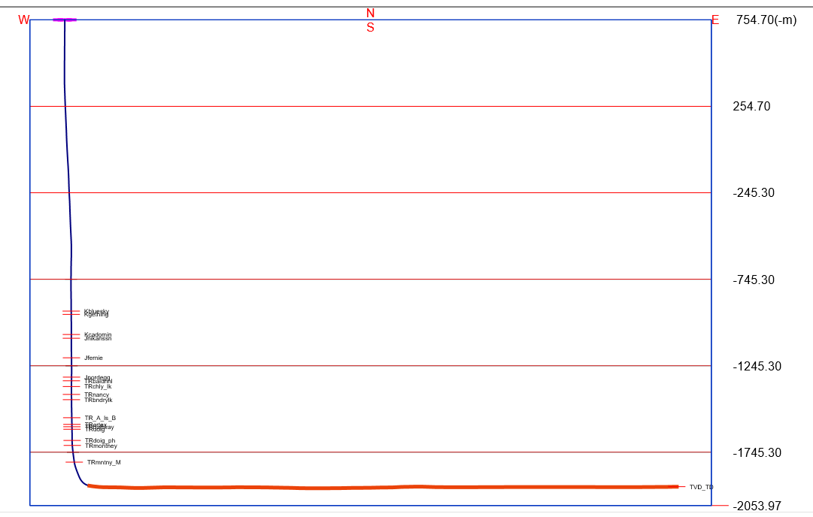
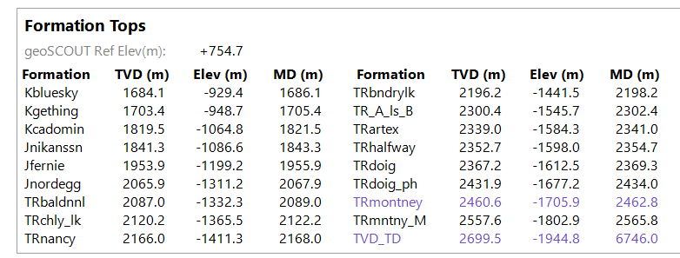
Section 2. Montney Geology
19
Notes:
As a well is drilled, intersections with known subsurface formations are also recorded in subsea elevation TVD and MD.

Slide 20
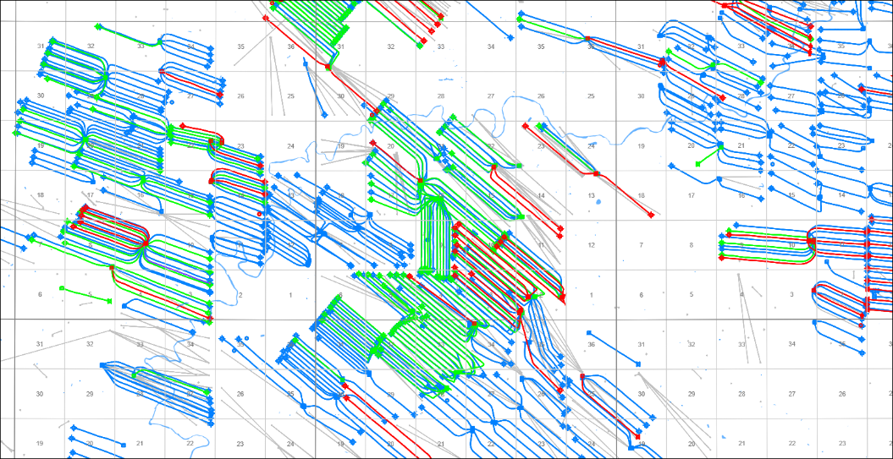
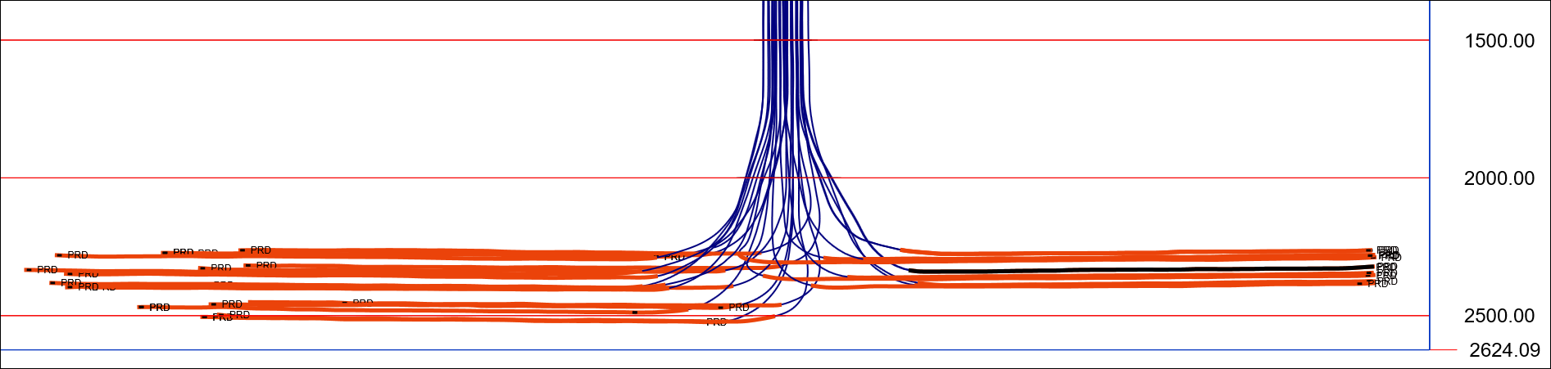
Section 2. Montney Geology
Montney HZ Targets are stacked or layered
BLUE top 100m
GREEN 100-200m
RED 200+m
20
Notes:
This is an example for a typical drill pad with many individual wells. Since the Montney is so thick, multiple intra Montney layers or “benches” may be targeted. Using drill survey data, it’s possible to highlight which well targets which benches. In B.C., the majority of completion induced IS events appear to be related to wells targeting the Lower Middle and Lower Montney benches.

Slide 21
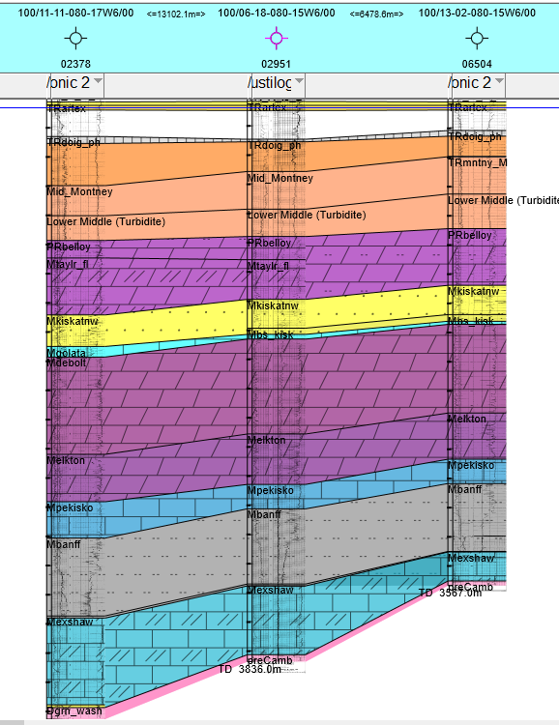
Section 2. Montney Geology
Montney Depths
Montney
TVDepth to top 1.2 to 3.0+km
Thickness 250-300+m
TVDepth below Montney
to basement 1.2 to 1.6 km
21
Notes:
The Montney is underlain by a significant thickness of older strata. Depth to granitic basement varies widely but generally it is about 1.2 to 1.6 km. There is also a complex and very significant relationship to underlying structural features that precludes the ability to make broad Montney wide conclusions regarding the impact and relationship to basement. It is critical to research and understand these relationships on a local level.

Slide 22
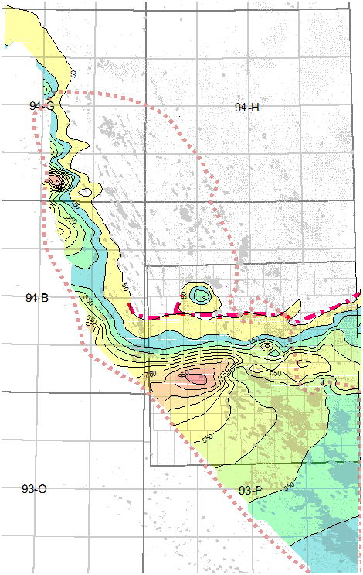
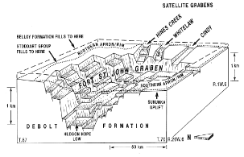
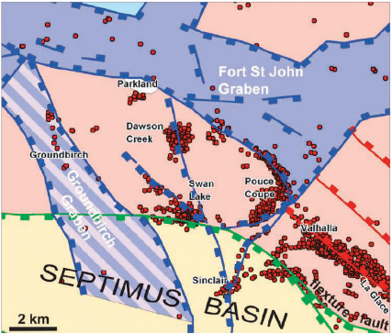
Section 2. Montney Geology
From: Z Berger et al CSPG Reservoir Feb 2009
Fort St. John Graben – Belloy to Debolt Isopach
From: Barclay et al Bulletin of Canadian Petroleum Geology Vol. 38A Dec 1990
22
Notes:
A primary example would be the Fort St. John Graben which manifests significant impact influence in the southern subareas of the Montney play trend throughout the lower geologic section and into the Montney. Its influences is impactful on a local scale and wells only a kilometer apart and may display significant differences in geologic conditions and character. It is thus critical to understand and relate to any study of the Montney.

Slide 23

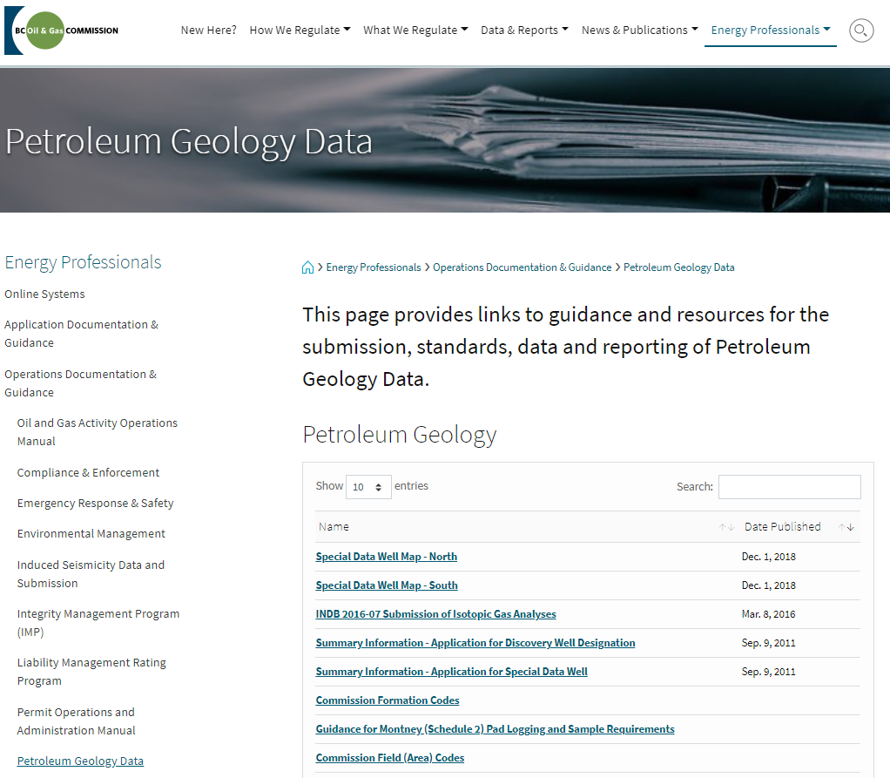
Section 2. Montney Geology
Commission
Petroleum Geology Group
Jeff Johnson
Supervisor, Petroleum Geology
Jeff.Johnson@bcogc.ca
Mark Hayes
Technical Leader, Resource Assessment
Mark.Hayes@bcogc.ca
Stuart Venables
Senior Petroleum Geologist
Stuart.Venables@bcogc.ca
Taylor Mennis
Petroleum Geologist
Taylor.Mennis@bcogc.ca
www.bcogc.ca/energy-professionals/operations-documentation/petroleum-geology-data/
23

Slide 24
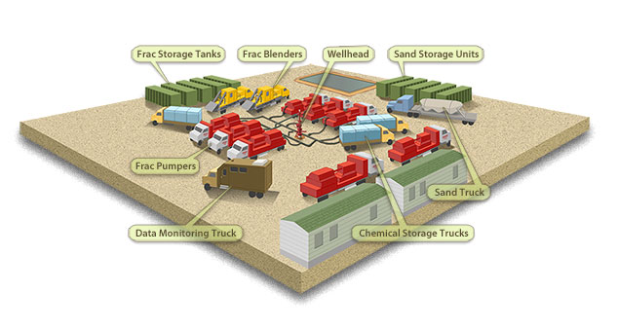
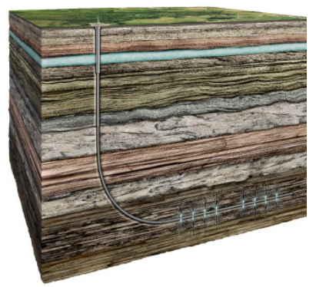
3. Hydraulic Fracturing
Activity in B.C.
What is Hydraulic Fracturing?
Hydraulic fracturing, commonly called “fracking”, is currently the only available technology that enables economic and effective recovery of unconventional natural gas and associated hydrocarbons from low permeability rock formations.
The image above
shows various surface facilities
and equipment used during the hydraulic fracturing process.
The image to the left shows a cross-section view of a typical horizontal well.
24

Slide 25
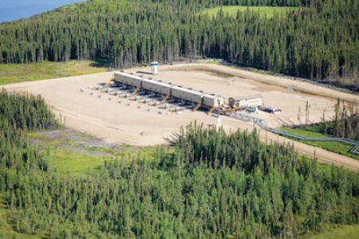
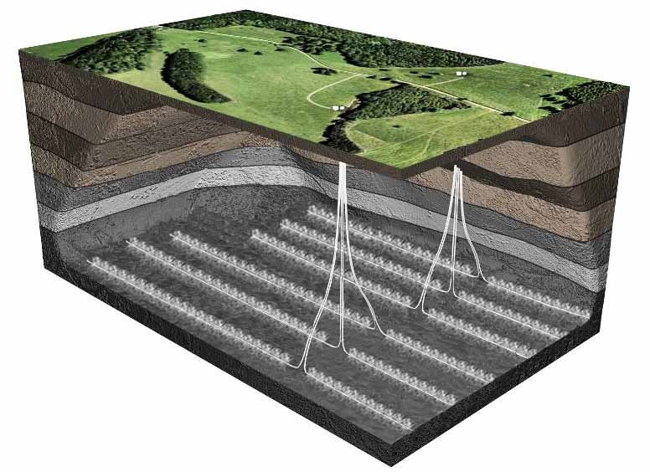
Section 3. HF Activity in B.C.
Multi-well Pads
Reduced surface impacts.
Fewer roads and utility corridors.
Increased ability to avoid sensitive areas.
Centralize infrastructure.
Economy of scale.
25

Slide 26
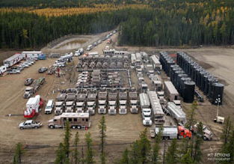
Section 3. HF Activity in B.C.
Hydraulic Fracturing
Process of creating artificial porosity (fractures) in shale deep underground.
Predominantly water and <1 % additives injected under very high pressure to fracture the rock.
A ‘proppant’ (often silica sand) mixed with the fluid and pumped into fractures to keep fractures open.
Natural gas then flows freely from the shale fracs to surface.
26

Slide 27
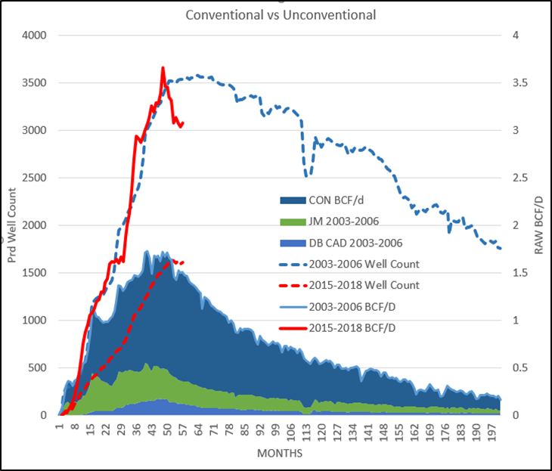
Section 3. HF Activity in B.C.
2000’s
Significant increase in natural gas price.
2005 and onward
Experimentation with expensive types of gas reservoirs – the shales and siltstones (unconventionals) required large-scale hydraulic fracturing to produce economic amounts.
2011
Production from unconventional gas
surpassed conventional gas.
27

Slide 28
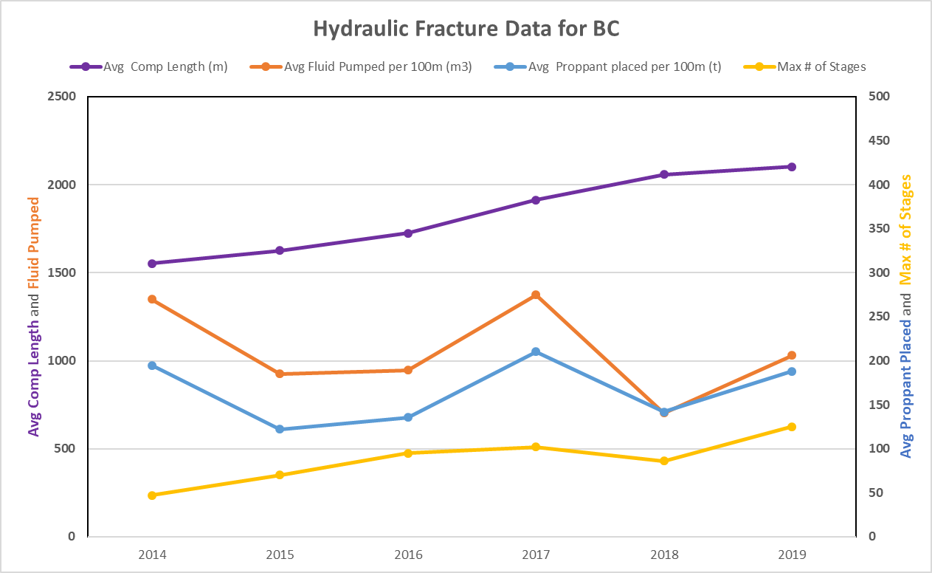
Section 3. HF Activity in B.C.
2014 to 2019 Hydraulic Fracture Data
This chart shows:
Horizontal well lengths are increasing.
Fluid pumped is changing – reflective of changing fracking technologies.
Proppant, which holds cracks open in the rock, has been following fluid changes.
Number of stages has increased, coinciding with longer well lengths.
28

Slide 29
Section 3. HF Activity in B.C.
Frac Data Submission Guide (bcogc.ca/node/8251/download)
Details requirements for fracturing data submission in B.C.
The horizontal portion of the well is partitioned into stages for the process of fracturing.
Each fracture stage has data requirements of time, date, rate, pressure, stage, length, proppant, etc. (refer to guide mentioned above).
Submissions are required as part of the Drilling and Production Regulation (refer to www.bclaws.ca/civix/document/id/complete/statreg/282_2010).
29

Slide 30
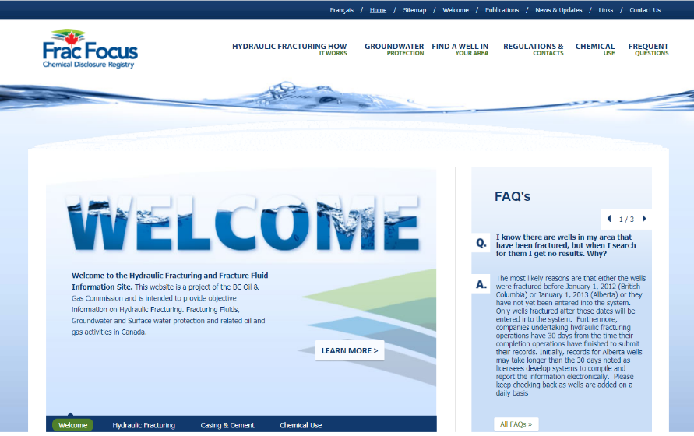
Section 3. HF Activity in B.C.
Hydraulic Fracture Fluid Transparency
Visit http://www2.fracfocus.ca/en
For More Fracking Info:
Drilling and Production Regulation.
BCOGC Frac Data Submission Requirements.
Interwell Communications Reports.
Ernst & Young ‘Review of British Columbia’s Hydraulic Fracturing Regulatory Framework.
Frac Fluid Disclosure.
CAPP Guiding Principles.
Data Downloads (see appendix).
eLibrary (see appendix).
Refer to this slide’s notes for list of hyperlinks.
Visit the online FracFocus registry to view objective information on hydraulic fracturing, fracturing fluids, groundwater and surface water protection, and more.
30
Notes:
Drilling and Production Regulation http://www.bclaws.ca/civix/document/id/complete/statreg/282_2010
BCOGC Frac Data Submission Requirements https://www.bcogc.ca/files/operations-documentation/Oil-and-Gas-Operations-Manual/Supporting-Documents/Hydraulic-Fracture-CSV-Guide-v.2.1-October-1-Release-2020.pdf
Reporting Inter-Wellbore Communications https://www.bcogc.ca/files/publications/Industry-Bulletins/ind-2015-15-reporting-inter-wellbore-communications.pdf
Ernst & Young Review https://www.bcogc.ca/files/reports/Technical-Reports/bcogc-hf-regulatory-review-appendix-c.pdf
Frac Fluid Disclosure http://www2.fracfocus.ca/en
Canadian Association of Petroleum Producers (CAPP) Guiding Principles for Hydraulic Fracturing https://www.capp.ca/wp-content/uploads/2019/11/CAPP_Hydraulic_Fracturing_Guiding_Principles_and_Operating_Practices_Guiding_Principles_for_Hydraulic_Fracturing-339105.pdf
See appendix
See appendix

Slide 31

4. Induced Seismicity (IS) in B.C.
Seismic Monitoring Timeline
History of IS in B.C.
Ground Motion Monitoring
Regulation of IS
Case Studies
Event Catalogue Link
31

Slide 32
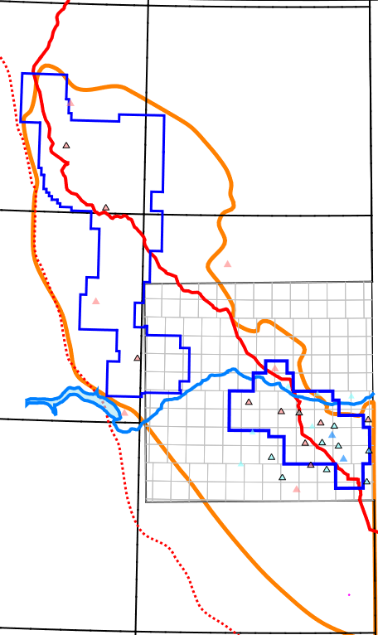
Section 4. IS in B.C.
Seismic Monitoring Timeline
Monitoring capabilities have changed significantly from 2012 to 2020. This means an ever-changing magnitude of accuracy and completeness of the event hypocentres.
1998
1st monitors added to NEBC by NRCan.
2015
Drilling and Production Regulation – s. 21.1.
2009
1st events in Horn River Basin (HRB).
2016
Ground motion monitoring areas introduced.
Add final station to CNSN upgrade.
2012
HRB seismicity report released.
BC Seismic Research Consortium formed.
2017
Update threshold for ground motion monitoring.
McGill deploys nine-station research array.
2013
Deploy six stations to enhance CNSN.
2018
Kiskatinaw Seismic Monitoring and Mitigation Area.
Deploy seven co-located MONT stations.
2014
Deploy two more stations to enhance CNSN.
Montney seismicity report released.
2019
Deploy two co-located MONT stations + two BCH
McGill deploys six more stations to research array.
32

Slide 33
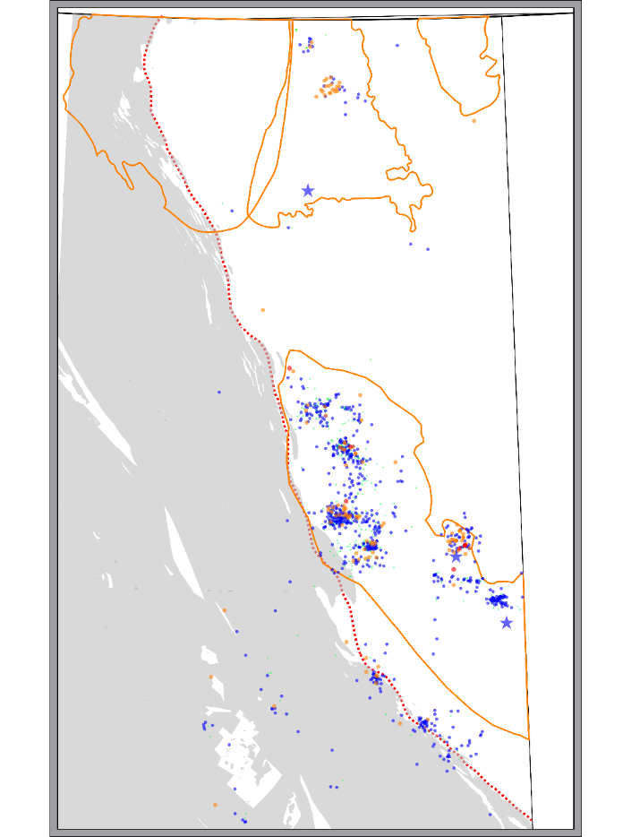
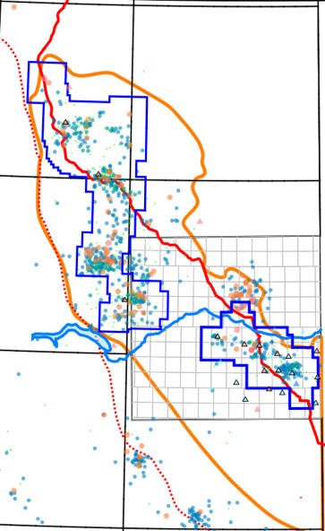
Section 4. IS in B.C.
History of IS in B.C. 1985 to Present
EVENT COUNT (≥3M_{L}): 134
3 & greater M_{L}: 134 4 & greater M_{L}: 10
EOR: 31 (4) HF: 56 (4) Disposal: 35 (1) HF/Disp: 8 (1)
Natural: 2 Prod: 2
Montney Trend
Legend (M_{L}):
4 and greater
3 to 3.99
2 to 2.99
less than 2
Suspected Cause
Induced Events
EOR
Disposal
Hydraulic
Fracturing
Distribution (≥3M_{L})
Horn River | 22
N. Montney | 71
S. Montney | 8
Eagle EOR | 31
Other | 2
Coal Mining (Blasting) Events
33

Slide 34
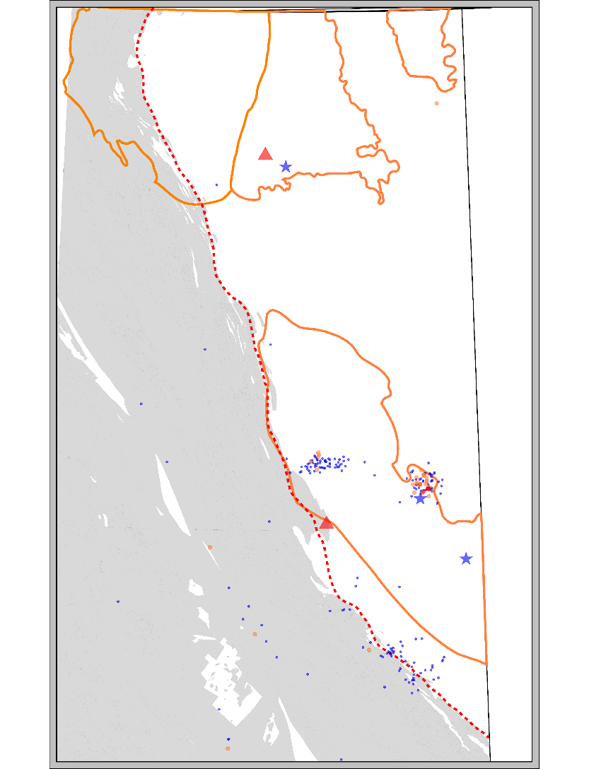
Section 4. IS in B.C.
History of IS in B.C. 1999 to 2008
EVENT COUNT (since 1985): 35
3 & greater M_{L}: 16 4 & greater M_{L}: 1
EOR: 29 (4) HF: 0 Disposal: 5
Natural: 1
Legend (M_{L}):
4 and greater
3 to 3.99
2 to 2.99
less than 2
Suspected Cause
Induced Events
NRCan (Natural Resources Canada) adds two (2) stations to NE BC as part of the CNSN (Canadian National Seismograph Network).
Injection rate drop at Eagle EOR project has effect on IS.
Begin to see evidence of IS related to Disposal in Graham.
EOR
Disposal
Hydraulic
Fracturing
34

Slide 35
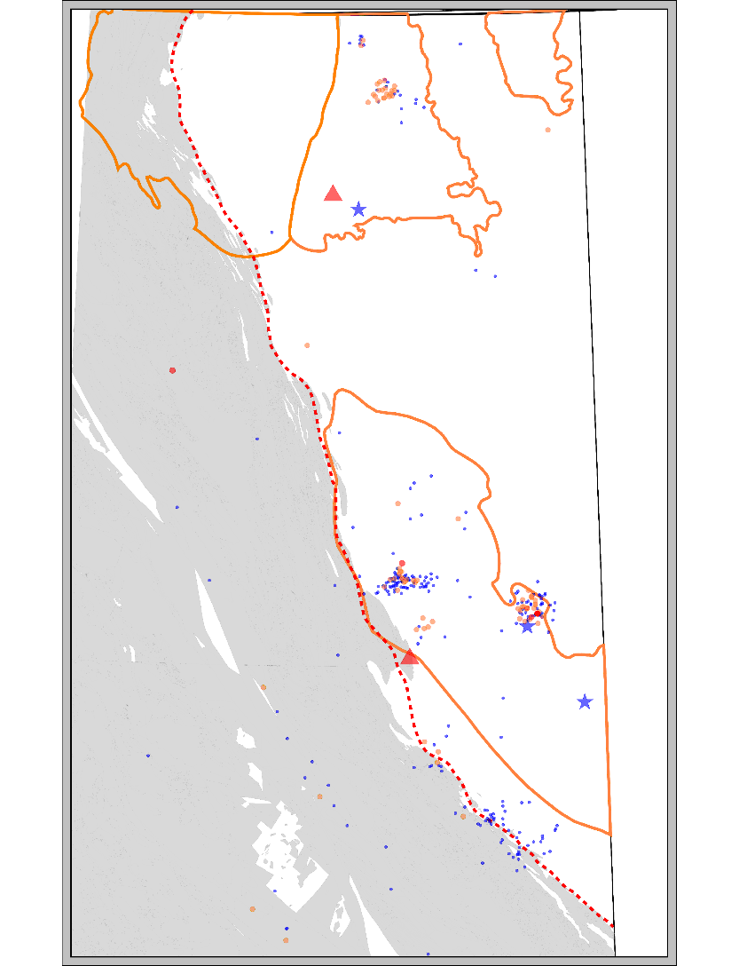
Section 4. IS in B.C.
History of IS in B.C. 2009 to 2012
EVENT COUNT (since 1985): 78
3 & greater M_{L}: 43 4 & greater M_{L}: 1
EOR: 32 (4) HF: 22 Disposal: 17(1) HF/Disp: 5
Natural: 2
Legend (M_{L}):
4 and greater
3 to 3.99
2 to 2.99
less than 2
Suspected Cause
Induced Events
Horn River Basin Events.
Report: Investigation of Observed Seismicity in the Horn River Basin.
Result: Well Permit Conditions placed on all new and existing permits operating in Horn River Basin.
Actions: Begin improvement of CNSN from 2 stations to 11.
Directed by the BC Seismic Research Consortium with Geoscience BC, NRCan, CAPP, and BCOGC.
EOR
Disposal
Hydraulic
Fracturing
Further reduce injection rate at Eagle – reduction in events evident.
Possible frac induced events in the Montney Trend.
35

Slide 36
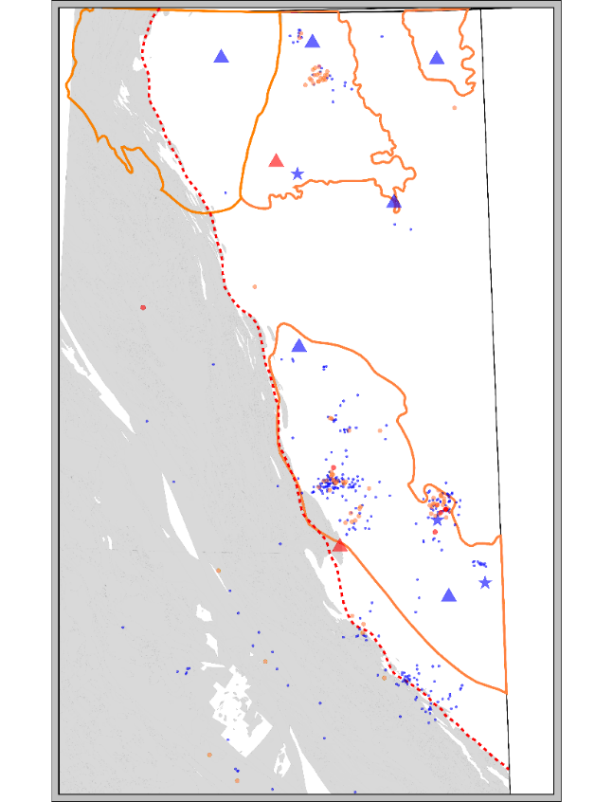
Section 4. IS in B.C.
History of IS in B.C. 2013
Suspected Cause
Induced Events
EVENT COUNT (since 1985): 84
3 & greater M_{L}: 6 4 & greater M_{L}: 1
EOR: 32 (4) HF: 24 Disposal: 20(1) HF/Disp: 6 (1)
Natural: 2
Legend (M_{L}):
4 and greater
3 to 3.99
2 to 2.99
less than 2
EOR
Disposal
Hydraulic
Fracturing
Six broadband seismographs stations added – HRB and shale basins well covered…no further events.
Gas price: 2009 – 2011= $4.11/mmBtu. 2012 = $2.88/mmBtu.
Horn River Basin: over-mature, dry gas with 10 per cent CO₂.
Oil price upward – Montney exploration reveals extensive liquids fairway.
WTI price: 2009 – 2011 = $78.64/Bbl. 2012 = $94.11/Bbl.
Further – evidence disposal related IS: complete review of all disposal wells initiated.
36

Slide 37
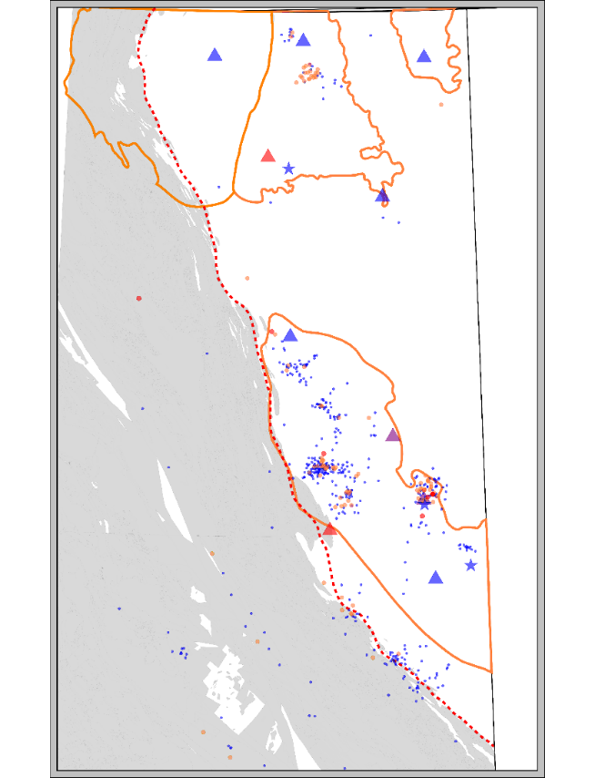
Section 4. IS in B.C.
History of IS in B.C. 2014
Suspected Cause
Induced Events
EVENT COUNT (since 1985): 94
3 & greater M_{L}: 10 4 & greater M_{L}: 1
EOR: 31 (4) HF: 30 (2) Disposal: 20 (1) HF/Disp: 11
Natural: 2
Legend (M_{L}):
4 and greater
3 to 3.99
2 to 2.99
less than 2
EOR
Disposal
Hydraulic
Fracturing
Added two more stations – along the Montney Trend.
Released Report: Investigation of Observed Seismicity in the Montney Trend.
Report links fracturing activities to induced seismicity within the Montney development.
Regulatory enhancements focused on induced seismicity taking learnings from permit conditions implemented at earlier date.
One EOR (Eagle) event – ML 2.2
37

Slide 38

Section 4. IS in B.C.
History of IS in B.C. 2015
Suspected Cause
Induced Events
EVENT COUNT (since 1985): 105
3 & greater M_{L}: 11 4 & greater M_{L}: 1
EOR: 31 (4) HF: 36 (3) Disposal: 21 (1) HF/Disp: 13
Natural: 2
Legend (M_{L}):
4 and greater
3 to 3.99
2 to 2.99
less than 2
EOR
Disposal
Hydraulic
Fracturing
Implemented induced seismicity oversight into regulations (DPR s.21.1).
Mandates shut-down at Mag. 4 for hydraulic fracturing and disposal.
Notification for any felt event.
Graham disposal well permanently shut-in.
Completed review of all disposal well leads to:
23 wells shut-in due to IS.
Seven wells shut-in due to reservoir pressure thresholds.
Two wells with IS concerns operate with additional constraints.
38

Slide 39
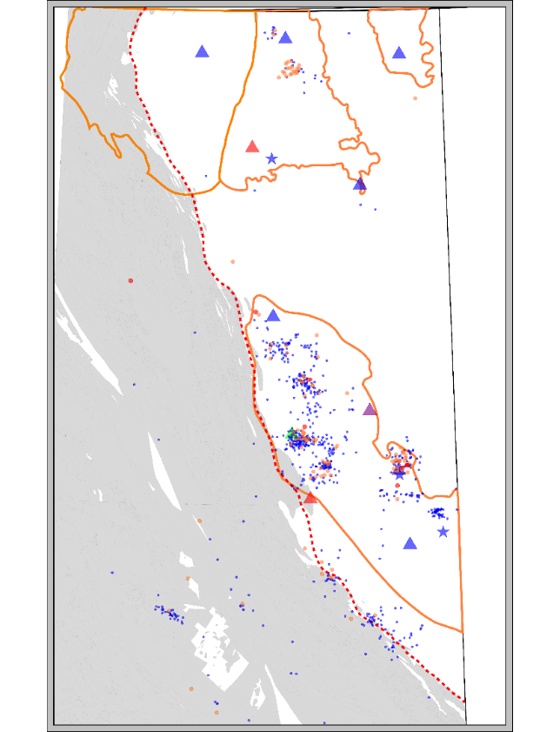
Section 4. IS in B.C.
History of IS in B.C. 2016
Suspected Cause
Induced Events
EVENT COUNT (since 1985): 112
3 & greater M_{L}: 7 4 & greater M_{L}: 0
EOR: 31 (4) HF: 58 (3) Disposal: 21 (1) HF/Disp: 8 (1)
Natural: 2
Legend (M_{L}):
4 and greater
3 to 3.99
2 to 2.99
less than 2
EOR
Disposal
Hydraulic
Fracturing
Implement permit conditions requiring ground motion monitoring.
Add additional station in Graham area (station donated by shut-in disposal well oversight array).
39

Slide 40

Section 4. IS in B.C.
History of IS in B.C. 2017 to 2020
Legend (M_{L}):
4 and greater
3 to 3.99
2 to 2.99
less than 2
EVENT COUNT (since 1985): 134
3 & greater M_{L}: 22 4 & greater M_{L}: 1
EOR: 31 (4) HF: 58 (4) Disposal: 35 (1) HF/Disp: 8 (1)
Natural: 2
Suspected Cause
Induced Events
Introduced Kiskatinaw Seismic Monitoring and Mitigation Area (KSMMA).
Added nine-station research area with McGill in KSMMA.
Fracture Review Panel.
Added additional nine stations through PGC partnership.
Eleven-station research array added in Q1 2020.
Five Geoscience BC studies underway.
EOR
Disposal
Hydraulic
Fracturing
40

Slide 41
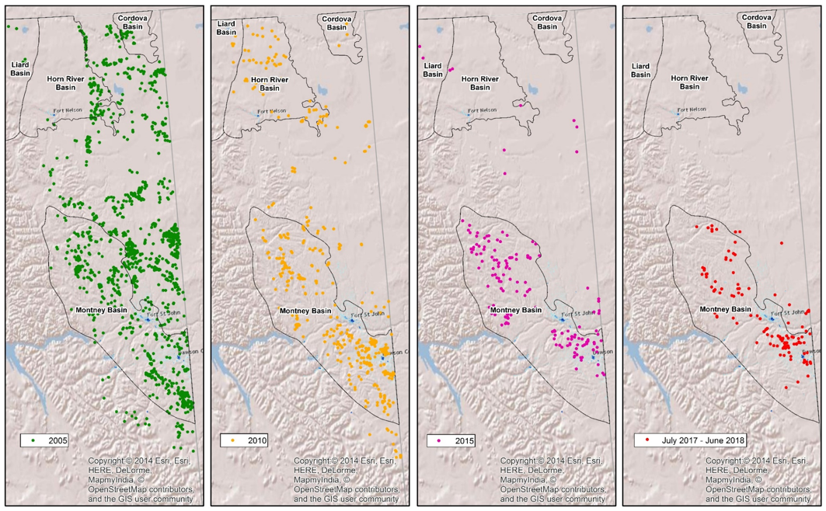
Section 4. IS in B.C.
History of IS in B.C. 2017 to 2020
Hydraulic Fracturing Activity Trends shown.
The seismic events followed the activity.
Green wells drilled up to 2005 - Conventional
Yellow 2010 – Focusing on HRB, Cordova, Liard and Montney. Much less on conventional.
Pink: 2015 – HRB, Liard and Cordova is largely abandoned (due to location, not resource) and operations focus on the Montney.
Red: 2017-2018 –Montney is the main activity.
41

Slide 42
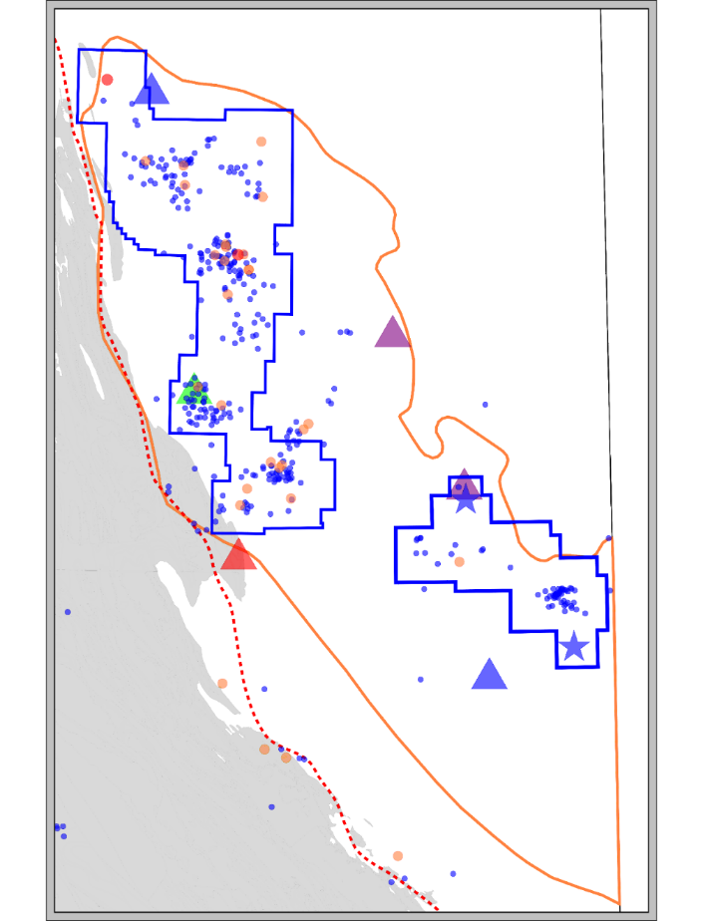
Section 4. IS in B.C.
Ground Motion Monitoring
Focused on areas with recorded events.
Focused on hydraulic fracturing activities.
Events equal to & greater than M3.0 and felt events.
Came into force as a permit condition on June 1, 2016.
Applies to wells permitted after June 1, 2016 within ground motion monitoring areas only.
Initially: All felt events and events above 2%g must be reported. Changed to events above 0.8%g in January 2018.
42

Slide 43


Section 4. IS in B.C.
Legend (M_{L}):
4 and greater
3 to 3.99
2 to 2.99
less than 2
Montney Trend – Felt Events. Ground Motion
Felt Event. Oct 2017
M_{L}: 3.2 |5.5%g | 1.96 cm/s
M_{L}: 3.0 | 2.7%g | 0.73 cm/s
Felt Event. Apr 2017
M_{L}: 2.4 | 2.5%g | 0.18 cm/s
Felt Event. Apr 2017
M_{L}: 2.5 | 4.5%g | 0.54 cm/s
M_{L}: 2.7 | 10%g | 0.74 cm/s
Felt Event. Jul 2017
M_{L}: 2.1 | 1.6%g | 0.14 cm/s
M_{L}: 2.4 | 1.9%g | 0.18 cm/s
M_{L}: 2.6 | 1.2%g | 0.13 cm/s
43

Slide 44

Section 4. IS in B.C.
Ground Motion Monitoring
What is the level of ground motion hazard?
44

Slide 45

Section 4. IS in B.C.
Ground Motion Monitoring
What is the level of ground motion hazard?
45

Slide 46



Section 4. IS in B.C.
Regulatory Tools for IS Management
Orders – Special Project or Directed
Reactive, immediately in-place for all prescribed activities.
Quick(er) to implement.
Localized.
Can be operator-specific.
Situation-based, go-forward for all prescribed activities.
Area-specific (usually). Can be regional/provincial.
Permit conditions provide flexibility in their application.
Implementation fairly straight-forward.
Can provide test case(s) for future regulation.
Permit
Conditions
(Near) permanent rule.
In-place from time of being deposited. Applies to all activities.
Introduction and implementation involves full regulatory process and drafting.
Regulation
46

Slide 47

Section 4. IS in B.C.
D. HF Order - Kiskatinaw Seismic Monitoring and Mitigation Area
Enhanced communication with residents.
Submission of seismic monitoring and mitigation plan including a seismicity risk assessment.
Notification within 24 to 72 hours of commencement of operations.
Deployment of accelerometer within three km of pad.
Real-time seismicity monitoring.
A reduced magnitude threshold for suspension of operations (3.0 ML).
Minimum level for activation of mitigation plan.
Requirement to report all events 1.5 ML and greater to the Commission.
Possible shut-in resulting from clusters of events.
Legend (M_{L}):
4 and greater
3 to 3.99
2 to 2.99
less than 2
47

Slide 48

Section 4. IS in B.C.
D. Disposal Regulations
Uncontained Disposal
B.C.: Contained Reservoirs
In British Columbia, oversight of disposal into contained reservoirs includes:
Defined application and pre-assessment process.
Limit wellhead injection pressure below fracture gradient.
Require monthly reporting of injection pressures, volume disposed and hours of operation.
Know your fluid density and therefore the hydrostatic column pressure.
Annually measure average reservoir pressure.
Limit maximum reservoir pressure. When the limit is reached, disposal at this site ceases.
Regulatory Success:
When small events occur, reduce injection rate and wellhead injection pressure. Events have been minimized to less than magnitude 3.0.
Province-wide, event frequency and magnitude is continuously declining.
48

Slide 49

Section 4. IS in B.C.
D. Disposal Order Example
Link to all Disposal Orders:
https://www.bcogc.ca/data-reports/reservoir-management/reservoir-approvals/
49

Slide 50

Section 4. IS in B.C.
Case Studies
Induced Seismicity due to Hydraulic Fracturing
Legend (M_{L}):
4 and greater
3 to 3.99
2 to 2.99
less than 2
50

Slide 51


Section 4. IS in B.C.
Case Studies
Upper and Lower
(Middle) Montney
A’
A
51

Slide 52

Section 4. IS in B.C.
Case Studies
Upper and Lower
(Middle) Montney
Upper
Lower (Middle)
Events linked per stage*
No events
10 events
*Based on timing
52

Slide 53



Section 4. IS in B.C.
Case Studies
IS Due to Pressure Maintenance: Eagle Field
Compartmentalized Reservoir led to high pressure pockets.
Image: Barclay et al.,1990
53

Slide 54



Section 4. IS in B.C.
Case Studies
IS Due to Disposal: Graham Field
Disturbed Belt.
Image: Thompson, 1981
Legend (M_{L}):
4 and greater
3 to 3.99
2 to 2.99
less than 2
54

Slide 55

Section 4. IS in B.C.
Event Catalogue Link
Note – seismometer population has varied over time and therefore so has Magnitude of Completeness and location accuracies.
The 2014-2016 catalogue (OF 8335) is downloadable at:
http://ftp.geogratis.gc.ca/pub/nrcan_rncan/publications/ess_sst/306/306292/of_8335.zip
The 2017-2018 catalogue (OF 8718) is downloadable at:
http://ftp.geogratis.gc.ca/pub/nrcan_rncan/publications/ess_sst/326/326015/gid_326015.zip
https://geoscan.nrcan.gc.ca/starweb/geoscan/servlet.starweb?path=geoscan/fulle.web&search1=R=306292
55

Slide 56

Regulations and Public Data
WHY WE COLLECT DATA
OIL AND GAS ACTIVITIES ACT [SBC 2008] Chapter 36
Purposes
4 The purposes of the commission include the following:
to regulate oil and gas activities in British Columbia in a manner that
provides for the sound development of the oil and gas sector, by fostering a healthy environment, a sound economy and social well-being,
conserves petroleum and natural gas resources,
ensures safe and efficient practices, and
assists owners of petroleum and natural gas resources to participate equitably in the production of shared pools of petroleum and natural gas;
to provide for effective and efficient processes for the review of applications for permits and to ensure that applications that are approved are in the public interest having regard to environmental, economic and social effects;
to encourage the participation of First Nations and aboriginal peoples in processes affecting them;
to participate in planning processes;
to undertake programs of education and communication in order to advance safe and efficient practices and the other purposes of the Commission.
56

Slide 57

Section 5. Regulations and Public Data
Definition of Data
"geological and geophysical reports" means geological, geophysical and other reports in the possession of the ministry or the Commission that have confidential status because of a designation made by the minister under section 122 (2) of the Petroleum and Natural Gas Act, but does not include well reports and well data;
"well reports and well data" means
information obtained from or about a well, including drilling reports, well history reports, unprocessed and processed log data, dipmeter surveys, directional surveys, drill stem test data and analyses, wire line data, pressure-volume temperature and flow test data and analyses, subsurface pressure data and analyses, completion information, reports respecting monitoring of hydraulic fracturing, geological and geophysical information, drilling depths, casing and cementing information, well status, gas, oil or water sample or analysis data, drill cuttings and cores and any analysis and description of the drill cuttings and cores, and
proprietary geological information, engineering data and supporting calculations contained in pre-application submissions for well permits, but does not include geological and geophysical reports.
57
Notes:
Link to Petroleum and Natural Gas Act: http://www.bclaws.ca/civix/document/id/complete/statreg/96361_01

Slide 58
Section 5. Regulations and Public Data
Public Well Data
Pore (reservoir) pressure
DFITs
Flow tests
Production
Fluid analysis
Hydraulic fracture
Well workovers
Disposal wells
Reservoir Data
Described on following slides
Well logs
Core → always at the operator’s discretion, but is taken and must be submitted and archived at the Core Facility in Fort St. John.
Cuttings → operators must take and submit drill cuttings from every well at 5 m intervals from 50 m above shallowest potential oil and gas reservoir (usually Bluesky) to TD.
Geology
Exemptions: schedule 2 wells, safety waivers, duplication of data, HZ well bores.
58

Slide 59
Section 5. Regulations and Public Data
Reservoir Data
Schedule 2 Areas (Montney, Horn River, etc.)
Pore (reservoir) pressure
Rules: one initial pressure test every 4 km – not depth dependent.
Where to find data → Data Downloads in the drill_csv.zip file.
Quality Control: Be aware of test types, duration of tests, type of analyses.
DFITs
Rules: used for initial pressure and closure pressure but currently, only initial pressure is added to the Commission database.
Where to find data → Data Downloads in drill_csv.zip AND Hydraulic_fracture_csv.zip.
Quality Control: Be aware of test types, duration of tests, type of analyses.
Hydraulic Fracture (Well Completions)
Rules: Throughout Drilling and Production Regulation.
Where to find data → Data Downloads in drill_csv.zip AND Hydraulic_fracture_csv.zip and in PDF format in the eLibrary file with naming convention WA_COMP_DATE.PDF.
Quality Control: Frac pressure data from 2012 to 2020 not subjected to quality control.
Well Workovers (Well repairs and rebuilds)
Rules: Many requirements when repairing or re-fitting wells.
Where to find: → Data and a PDF Report must be submitted. See eLibrary for individual well workover reports or Data Downloads compl_wo.csv.
Quality Control: PDF reports have details of the operations on the site but they are time consuming to go through. The details provided vary, but are usually a good source of information about the completions process.
59
Notes:
Links:
a.i. Pore pressure. Rules: http://www.bclaws.ca/civix/document/id/complete/statreg/282_2010#division_d2e6635
b.i. DFITs. Rules: http://www.bclaws.ca/civix/document/id/complete/statreg/282_2010
c.i. Hydraulic Fracture. Rules: http://www.bclaws.ca/civix/document/id/complete/statreg/282_2010
d.i. Well workovers. Rules: claws.ca\civix\document\id\complete\statreg\282_2010

Slide 60
Section 5. Regulations and Public Data
Reservoir Data continued
Schedule 2 Areas (Montney, Horn River, etc.)
Flow tests
Rules: In Montney wells, flow tests occur in every well primarily to clean out the frac sand.
Where to find data → Data Downloads aofp_tst_csv.
Quality Control: Duration of test matters. Be sure to read flow test PDF files in the eLibrary.
Production Reporting
Rules: Reported monthly through the B.C. Government system call Petrinex.
Where to find data → Data Downloads in prod_csv.zip.
Quality Control: Volume is by the month, not the hour or the day. Some days may be high rate production while others may be low or shut-in.
Fluid analysis
Rules: Must take a fluid sample from every well and submit analysis.
Where to find data → Data Downloads oil_anal.csv, gas_anal.csv wtr_anal.csv.
Quality Control: Sample location, method and containers matter.
Disposal wells
Rules: See comprehensive Summary Document here.
Where to find data → Data Downloads water_gas_disposal.csv.
Quality Control: Volumes reported are by the month, not hour or day. Pressure reported is the maximum pressure in the month; not the average. The highest pressure may have been short duration but we expect it was a minimum of five minutes.
60
Notes:
Links:
e.i. Flow tests. Rules: https://www.bclaws.ca/civix/document/id/complete/statreg/282_2010#division_d2e6635
f.i. Production reporting. Rules: same as link above.
g.i. Fluid analysis. Rules: same as link above.
h.i. Disposal wells. Rules: same as link above. Summary Document: https://bcogc.ca/node/5997/download

Slide 61
Section 5. Regulations and Public Data
Hydraulic Fracture Data Summary
The Commission collects hydraulic fracture data through three submissions:
The fracture fluid disclosure (Frac Focus) submission:
Frac Fluid Disclosure – (all submission) https://reports.bcogc.ca/ogc/f?p=200:2:1057249272671::NO::: or (individual submissions) http://www.fracfocus.ca/endata.
The hydraulic fracture data submission (Frac.csv):
Hydraulic Fracture Data: https://iris.bcogc.ca/download/hydraulic_fracture_csv.zip.
This data is an export from the Commission’s system. The export is refreshed once a month, on or around the 10th.
Data is exported once reviewed by Commission staff; this may result in a delay compared to FracFocus or the Completion/Workover Report.
Data is presented by WA and a separate line of data is published for each stage. Injection volumes are captured in the “Total Fluid Pumped” column.
The Completion/Workover Reports:
Details of hydraulic fractures must also be reported in the corresponding Completion/Workover Reports.
These reports are published in PDF format via the eLibrary as “COMP” documents. The eLibrary is free to access but you must obtain a user name and password (https://www.bcogc.ca/energy-professionals/online-systems/elibrary/).
The Commission collects water production data as follows:
NOTE: All water produced from a well, including flow back of load fluid, is to be reported as water production.
B.C. Total Production Report - https://reports.bcogc.ca/ogc/f?p=200:8:15361179614398::NO:::
Drilling Data for All Wells in B.C. - https://iris.bcogc.ca/download/drill_csv.zip.
Clean up tests - In the AOF file you will find summary records for all clean-up test submissions (test type = CU). Each line of data represents a single test. Since 2015, clean up tests are submitted to the Commission as a “PRD.” All PRDs are made available in the eLibrary and include a detailed data file (.pas). Prior to eSubmission clean up flow tests were submitted in paper and, if scanned, are available in the eLibrary as “AOF” documents.
61
Notes:
Links:
e.i. Flow tests. Rules: https://www.bclaws.ca/civix/document/id/complete/statreg/282_2010#division_d2e6635
f.i. Production reporting. Rules: same as link above.
g.i. Fluid analysis. Rules: same as link above.
h.i. Disposal wells. Rules: same as link above. Summary Document: https://bcogc.ca/node/5997/download

Slide 62

Section 5. Regulations and Public Data
Commission Reservoir Engineering
www.bcogc.ca/energy-professionals/operations-documentation/reservoir-management/
Ron.Stefik@bcogc.ca: Supervisor.
Responsibilities: All of the below, and more!
Michelle.Gaucher@bcogc.ca: Reservoir Engineer.
Waste gas disposal, induced seismicity, hydraulic fracture
analysis, pressure and flow testing.
Petra.Kriescher-Trudgeon@bcogc.ca: Reservoir Engineer.
Pressure maintenance, oil and gas differentiation, reserves.
Logan.Gray@bcogc.ca: Reservoir Engineer.
Water disposal wells, abandonments.
Sara.Li@bcogc.ca: Reserves and Production Analyst.
Production data, well statuses, reserves.
Kathryn.Archibald@bcogc.ca: Well Test Analyst.
Pressure and flow testing, production, reservoir data
management.
Karen.Diamond@bcogc.ca: Well Analyst.
Frac data reviews, well workover review.
62

Slide 63
Section 5. Regulations and Public Data
Geology
Schedule 2 Areas (Montney, Horn River, etc.)
Geology Data eLibrary
FTLR - Formation Tops Logs Run.
GEOL – Wellsite Geological Reports for majority of wells good source of well drilling data summary (no completion).
CORE – all analyses and summary reports.
Well logs
Strip Logs – wellsite summary on Vertical build and HZ sections GR drill cuttings and mud gas readings ROP etc…
OH logs - one per pad minimum requirements GR, N, elog, porosity log.
Core
At discretion of operator any analyses performed must be submitted.
Every P&NG Core is public, submitted and warehoused in Fort St. John and is available for viewing and subsequent analyses.
Formation Tops
Wellsite Geology Reports and FTLR.
63

Slide 64
Section 5. Regulations and Public Data
Geology
Schedule 2 Areas (Montney, Horn River, etc.)
Essentially logging and sample requirements are on a pad basis; rather than by well.
SAMPLES
for horizontal wells drilled from a common drilling pad location and to be completed in a zone listed in Schedule 2, take drilling cutting samples as follows:
What Depth → i) for a minimum of one horizontal well on the pad location, at 5 m intervals beginning at a point determined by the permit holder to be 50 m measured depth above the shallowest potential reservoir zone expected in the well and continuing to the point at which the drilling of the horizontal portion of the well is begun;
How Many → (ii) for a minimum of one well on the pad location in each dominant direction of the horizontal portion of the well for each zone listed in Schedule 2, at 10 m intervals beginning at the point at which the drilling of the horizontal portion of the well is begun and continuing to the total depth of the well.
LOGS
If more than one well has been drilled or has been permitted to be drilled from a common drilling pad location in an unconventional zone listed in Schedule 2, the logs referred to in subsection (1) must be taken in at least one of the wells and, in the case of the other well or wells,
(a) subsection (1) does not apply, and
(b) a gamma ray log must be taken from the base of the surface casing of each well to total depth of each well.
64

Slide 65
Section 5. Regulations and Public Data
Practical Limitations to Geological Data
General
Limited data above prospective hydrocarbon bearing zones.
Today’s activity is geographically and stratigraphically focused.
90 per cent+ wells are HZ development wells in Schedule 2 areas.
Geological Data is available but not organized/searchable - requires well by well searches – digital data formats are minimal prior to 2014.
Samples (drill cuttings) – non existent in shallow zones (to mud-up) often no geologist on site until prospective HC intervals.
Logs Through casing GR difficult to interpret in shallow zones on its own (i.e. depth to bedrock can be challenging). Shallow neutron only a relatively recent requirement.
Tests DST’s not run anymore & in the past only on prospective HC zones.
Tops variable stratigraphic terminology not standardized (historical terms and equivalencies make it complicated especially in the shallower non HC prospective horizons = NOT RELIABLE).
65

Slide 66
Section 5. Regulations and Public Data
Finding Well Data
By Individual Well Authorization (WA) Number
By Consolidated Categories
(e.g.: all frac data)
eLibrary: The digital archive of well data and reports is available for viewing or downloading through the Commissions ftp site. Access to the ftp site is free of charge and available to the public. To request your unique username and password, enter “eLibrary FTP Access Request” in the Information Request text box.
The eLibrary is not a fulsome representation of all the well file data the Commission has. In July of 2014, the Commission began only accepting well data in electronic format. Any data received since then, whereby the statutory confidential period has expired, will appear on the eLibrary. The Commission has also begun scanning and adding historical well files to the eLibrary, but, at present, the vast majority of the data remains in hard copy.
If there is data you believe is available, but is not present on the eLibrary, you can request that information. Be aware requests for data may be subject to a charge.
Data Downloads: There is digital data available for download through the Commission’s Data Downloads portal. Access to this portal is free of charge and available to the public.
The Data Downloads portal contains raw data, typically in csv format, of oil and gas activities. Both of these databases can be accessed free of charge, however they both require you to sign up whereby you’ll receive a unique username and password for each database.
66
Notes:
Links
Data Downloads: https://reports.bcogc.ca/plogc/Ext_Accnt.Logon. First time users need to create an account.

Slide 67

Section 5. Regulations and Public Data
Finding Well Data
Start: the Commission Online Systems
https://www.bcogc.ca/data-reports/data-centre/
67

Slide 68


Section 5. Regulations and Public Data
eSubmission to the eLibrary: Data collected through eSubmission.
Finding Well Data
eLibrary: Data in folders for each well.
File types eSubmitted.
eSubmission manual https://old.bcogc.ca/node/12392/download
68

Slide 69

Section 5. Regulations and Public Data
Data Downloads
Spreadsheet data collections
69

Slide 70


Section 5. Regulations and Public Data
Commission
Map-based Data
http://data-bcogc.opendata.arcgis.com/
70

Slide 71
Section 5. Regulations and Public Data
3rd Party Data Vendors
AccuMap or geoSCOUT
Supply INTEGRATED data with value added (digital with interpretive capability) all in one spot via a searchable map based user interface (compared to Commission data - well by well).
Searchable by almost any well data, map or production attribute – very powerful tool.
Well logs available all in smart rasters and often LAS available.
Cross section capability top picking link to user databases.
Well data accessible right from the well ticket selectable from the map.
Direct link to actual Commission well data files and documents – all scanned.
User well data can be added and integrated with all other data sets.
71

Slide 72

Section 5. Regulations and Public Data
Data Caution
Formation Tops
Operator tops not reliable.
Inconsistent picks - some “tops” easier than others.
Highly variable terminology used – esp. in shallow section (above Bluesky) & regionally.
Best to use your own (user data base) locally.
Some vendors perform value added picks by their own geologists.
72

Slide 73


Section 5. Regulations and Public Data
Well Logs
X-S and top picking capability.
Well logs – Acculogs module
Best source for depth registered smart rasters with header and footer options.
73

Slide 74

Section 5. Regulations and Public Data
How to Request Well Data
Use the Commission request form at: https://www.bcogc.ca/contact/well-data-request-form/
74

Slide 75
Commission Research Priorities
Items that would benefit from further research:
Mitigations modelling.
Mechanisms of fault activation.
Compare seismic vs. aseismic areas.
What is the mechanism or physics behind event during flow back? Is it possible? When? How large?
Mitigation strategies review.
Explain production induced events.
75

Slide 76
Commission Research Collaborations to date
NRCAN and the Pacific Geoscience Center
Mahani Geophysical Consulting Inc.
Geoscience BC
BC OGRIS
University of British Columbia
McGill
University of Calgary
University of Alberta
Enlighten Geomechanics
Nanometrics
Golder Associates
76

Slide 77






Closing Thoughts
When it comes to the complexity of induced seismicity, a multi-discipline approach is required to gain insight.
Know your geology, reservoir, geomechanics and seismological history.
Know the pitfalls of the data.
Contact the Commission for input and our hands-on, ground truth practical knowledge on all things Montney and B.C. seismicity.
FACEBOOK
TWITTER
LINKEDIN
INSTAGRAM
YOUTUBE

