Slide 1
BRFN Implementation Agreement Update
Presenter: Mike Shepard, BCER

Slide 2
New Consultation Process
In the Implementation Agreement BRFN and BCER agreed to develop a new consultation process that:
(i) defines how applications will be categorized, from the perspective of an initial assessment of impacts to Treaty Rights;
(ii) provides a predictable workflow process and resourcing expectations for the Province and BRFN.
Co-Developed Process
Specific to the Yahey Decision
Outstanding Pieces
BRFN & BCER have worked together to develop a process that meets the requirements of the agreement and that also supports BRFN and BCER decision making.
Together we have focused on addressing the issues outlined in the Yahey decision.
BRFN and BCER are continuing to work together to develop outstanding pieces, such as conditions and mitigation measures.
www.bc-er.ca

Slide 3
New Consultation Process
Timelines
The new consultation process includes a 30 business day review and response period where BRFN has committed to reviewing and providing a response on applications within that timeframe. For some application, dialogue will follow.
We anticipate that many application types will have a shorter timeframe than the 30 days mentioned above.
The new process includes and Issue Resolution Process that can be used by BRFN or BCER when agreement isn’t able to be reached.
bc-er.ca
3

Slide 4
Pre-Application Engagement
All applications now require a pre-engagement report to be submitted that outlines the process that was used to pre-engage with BRFN and discuss any concerns that were brought forward and how they were addressed. BRFN intends to review these reports before the application is submitted.
Early in the Process
Identify All Components
Minimization & Consolidation
Engagement should be conducted well before applications are prepared.
Engage on the whole project and development plans, not just individual applications.
Discuss minimization of New Disturbance and consolidation of new activities with existing or planned disturbance.
bc-er.ca
4

Slide 5
Trapline Pre-Application Engagement
Distinct Process from the RCNR
This engagement is to meet the requirements in Article 14.5 of the Implementation Agreement
Should be arranged through pre-application engagement with BRFN Lands Department.
Does not fulfill the requirements of RCNR but supports it.
Not required for all applications, important to inform BRFN Lands Department when development plans overlap with BRFN traplines.
5

Slide 6
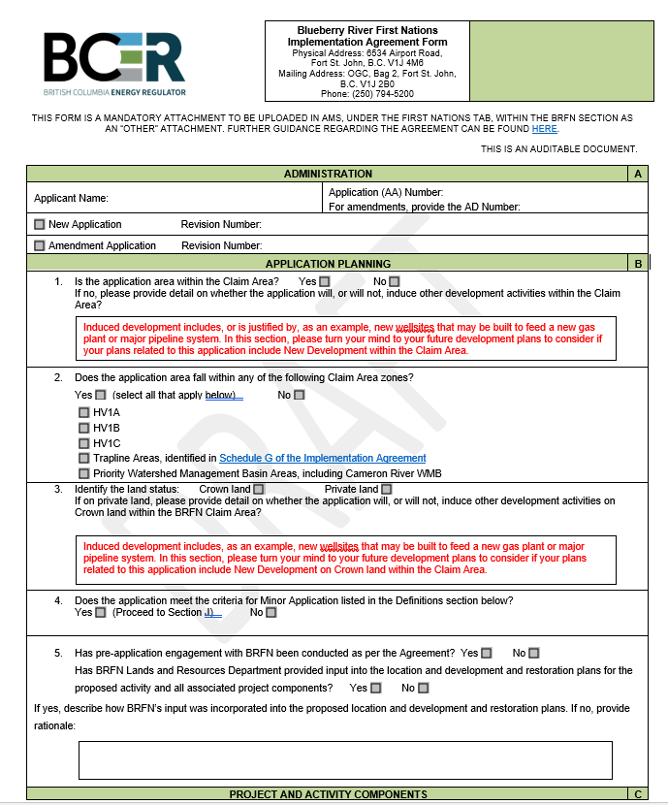
New BRFN Form & Guidance
New Form
Capture’s Agreement Requirements
Aids in BRFNs and BCER’S Application Review
bc-er.ca
6

Slide 7
New BRFN Form & Guidance
Information requirements for all applications within BRFN traditional territory:
The new BRFN Form requires that proponents provide more detailed information including:
Application location and New Disturbance.
Related applications that will be needed to complete the project.
Any ‘induced’ development that would be justified or likely occur as a result of the application (i.e. new facility, justified by new well pads).
How the application ties into a broader development plan (2-3 years and 5-10 years).
Efforts to use previously disturbed sites and to limit New Disturbance as much as possible.
Adherence to the setbacks and other rules of the Agreement.
Restoration Information specific to the application.
bc-er.ca
7

Slide 8
Setbacks and Other Matters
Old Growth
Moose Habitat
Campsites, spiritual, medicinal sites
Licks, wallows and cultural trails
Riparian Areas
And More
Cabins
bc-er.ca
8

Slide 9
Questions?
FACEBOOK
TWITTER
LINKEDIN
Scan here to see the BCER’s Strategic Plan on a Page
(S-PoP)
INSTAGRAM
YOUTUBE

