Slide 1
Managing Orphan Sites
Presenter: Mike Janzen
Exec. Director, Orphans and Restoration
Notes:
Don’t forget to Introduce yourself before you present your slides.
If appropriate, acquaint yourself with your audience by sharing your areas of interest and expertise. This will help your audience understand your background and perspective.
Office-specific Territorial Acknowledgement: If you are presenting from your office (or home), you may wish to acknowledge the traditional territory appropriate for your location. Office-specific territorial acknowledgements can be found on Energy Exchange in the Learning Centre under the Indigenous Relations tab.
Area-specific Territorial Acknowledgement: If you are able and it is appropriate, source the acknowledgement for the People/s, Territories and/or Treaty areas in which you will be presenting.
Alternately, you may verbally express the acknowledgement below to your audience.
Province-wide Territorial Acknowledgement:
We acknowledge and respect the many Indigenous Territories and Treaty areas, each with unique cultures, languages, legal traditions and relationships to the land and water, which our work spans.
We also respectfully acknowledge the Métis and Inuit people living across B.C.

Slide 2
bc-er.ca
2

Slide 3
Our Vision
Our Mission
A resilient energy future where B.C.’s energy resource activities are safe, environmentally leading and socially responsible.
Protect public safety.
Safeguard the environment.
Support meaningful reconciliation.
Advance public interest and contribute to B.C.’s economy
Our Values
RESPECT INTEGRITY TRANSPARENCY INNOVATION RESPONSIVENESS
bc-er.ca
3
Notes:
Building on more than 25 years of dedicated service, our purpose is to regulate energy resource activities in a manner that:
protects public safety and the environment
supports reconciliation with Indigenous peoples
supports the transition to low-carbon energy
conserves energy resources, and
fosters a sound economy and social well-being.

Slide 4
Our Role
We oversee activities from exploration and development, to pipeline transportation and reclamation. Our role includes refineries, value added gas and liquids manufacturing processes, aspects of geothermal power, and will expand to include hydrogen, ammonia and methanol.
bc-er.ca
4
Notes:
We are a single-window agency responsible for overseeing the full life cycle of energy resource activities in B.C., from site planning through to restoration. Companies looking to explore, develop, produce and market various energy resources in B.C., must apply to the BCER.
We collaborate across government and industry, sharing policy and technical expertise in support of B.C.’s transition to low-carbon energy and helping meet future global energy needs.
We are self-funded through the application of industry fees and levies and are accountable to the provincial legislature and the public through the Ministry of Energy, Mines and Low Carbon Innovation.

Slide 5
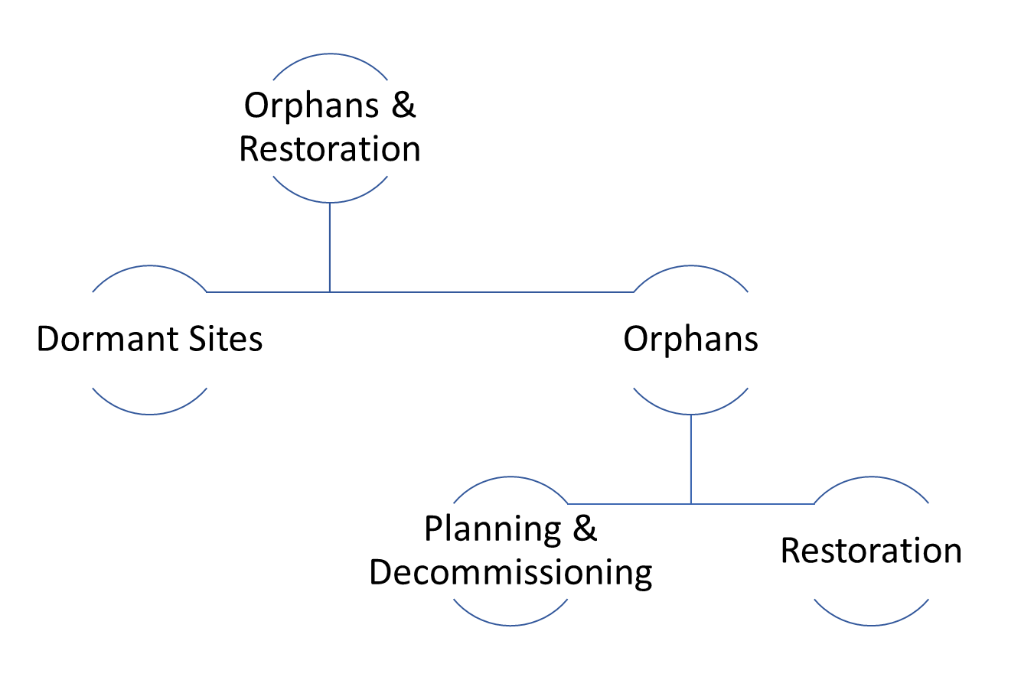
Who We Are
bc-er.ca
5

Slide 6
Comprehensive Liability Management Plan (CLMP)
The CLMP was released on May 31, 2019 along with the Dormancy Regulation. The CLMP has three primary components:
Improving the rate of inactive site restoration
Modernizing liability management
Addressing orphan sites
The CLMP provides a path forward to address unrestored oil and gas sites, protect public safety and safeguard the environment.
6

Slide 7
About the Orphan Site Reclamation Fund
The BCER addresses concerns about inactive oil and gas sites in B.C. that may no longer have a viable operator.
In cases where an oil and gas operator is insolvent or cannot be located, the BCER may designate the operator’s sites as orphans.
Once declared an orphan site, the our team restores using the industry-funded Orphan Site Reclamation Fund.
Land owners are not responsible for orphan sites on their land.
bc-er.ca
7

Slide 8
Funding for the Orphan Site Reclamation Fund
The BCER sets the orphan funding required in a given year and charges permit holders a levy, currently set at $15 million per year. Each permit holder will pay a percentage of the total levy, which is based on their share of the total B.C. restoration liability.
bc-er.ca
8

Slide 9
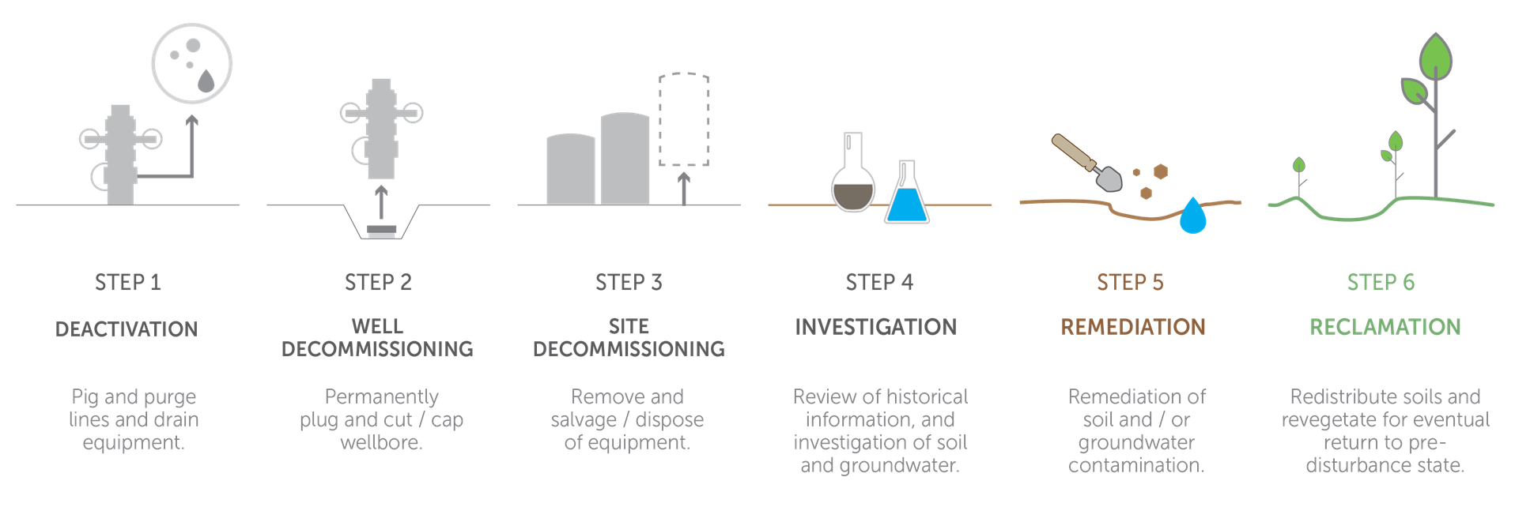
Restoration Process
bc-er.ca
9
Notes:
Emphasis on the fact that after everything has been removed from the surface is the end of the decommissioning phase but only half way through our process
Questions as to why we are “dragging our feet” after removing infrastructure and before planting and turning back over to landowner

Slide 10
Orphan Wells in BC
bc-er.ca
10

Slide 11
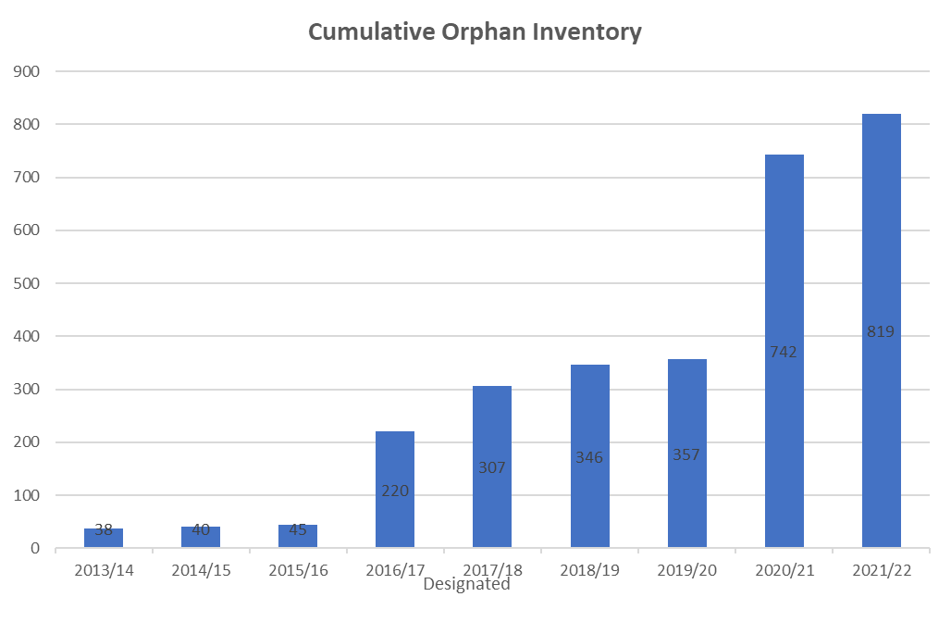
The Trend of Orphans
Uptick in Orphans
Currently the inventory of orphans is:
819
bc-er.ca
11

Slide 12
75%
Sites Projected to be Decommissioned
At the end of March 2023
Sites Projected to be Reclaimed
25%
At the end of March 2023
bc-er.ca
12

Slide 13
Compensation for Orphan Sites
Compensation may be provided by the BCER for missed rental payments for orphan sites. There are two ways to apply for compensation if a land owner has an orphan site:
For back payments prior to orphan designation: For land owners that wish to be compensated for rental payments that were missed before a site was designated an orphan, an application(s) should be made to the SRB to obtain an order for payment from the permit holder. The BCER will consider the order(s) in determining whether back payment can be provided.
For ongoing payments after orphan designation: For rental payments that are missed after the date of orphan designation, an application can be made directly to the BCER, and any awarded compensation will be automatically processed every year.
he
bc-er.ca
13
Notes:
To be approved we need documentation that links the amount the company paid, the date the payment is to be made (anniversary date) and the LOCATION – legal land description, grid location or PID. The original lease agreement is the best place for this.
Once approved the compensation is paid until we have finished the restoration process and Certificate of Restoration. We will not just stop paying without letting you know that we have reached this step.
Questions have come in asking us to confirm that we will only pay 50k on a well. Some landowners have just asked for this, some are concerned it means that we will walk away once a money limit is reached. Not sure where this originated but it is not true. We spend what we need to make sure the site reaches the restoration standards. We do not make lumpsum payments to a landowner to get out of the liability.

Slide 14
Liens & Rental Payments
It is not the responsibility of the land owner to pay property taxes owed by oil and gas companies.
The BCER has not been granted any powers to address compensation, taxes and liens on personal property.
We have engaged the Ministry of Energy, Mines and Low Carbon Innovation about liens and they are looking for ways to prevent and address the issue.
Land owners with liens on oil and gas sites on their property may contact the Land Title and Survey Authority to inquire about removal.
For sites that are not orphans, missed rental payments may be pursued through the Surface Rights Board (SRB), which is responsible for compensation on private land.
bc-er.ca
14

Slide 15
Orphan Protection and Restoration Plan
This plan outlines steps to ensure protection of public safety and the environment.
Deactivate pipelines and abandon high priority wells within 12 months.
Once sites are made safe, closure work considers the interests of impacted private land owners, the interests of impacted Indigenous communities and restoration goals.
Work to achieve restoration of orphan sites within 10 years.
Commitment to cost efficiency and program excellence.
bc-er.ca
15
Notes:
Use these slides to partition your PowerPoint into the sections listed in your agenda.

Slide 16
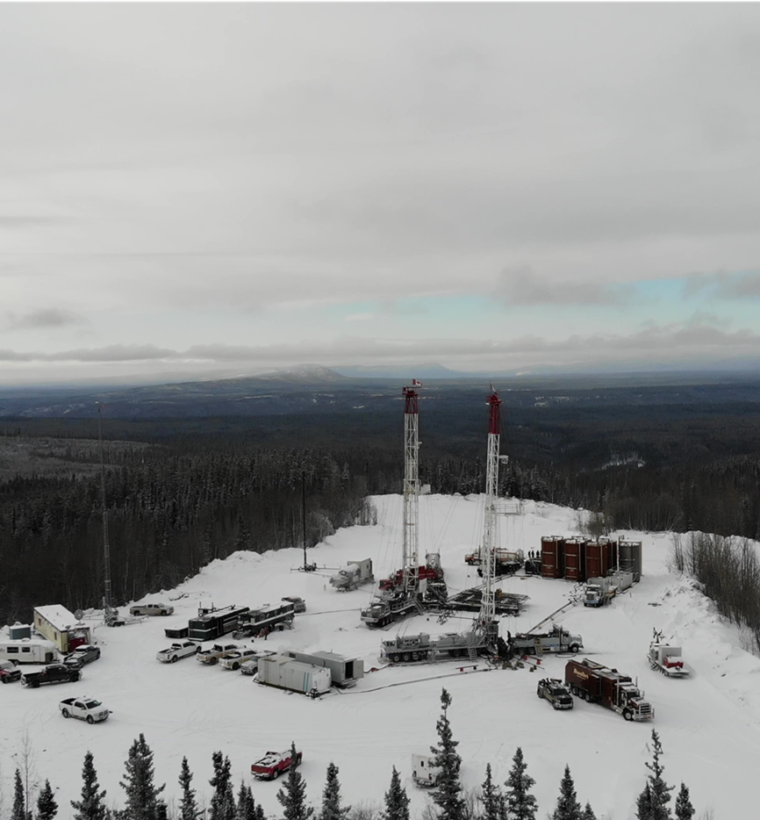
Efficient, Area-Based
Closure
In all season access, large-scale abandonment, decommissioning, and investigation programs are completed for the entire field – plan for remediation & reclamation.
In winter access, all programs are completed in a single season, where possible – take advantage of open access and minimize costs.
16

Slide 17
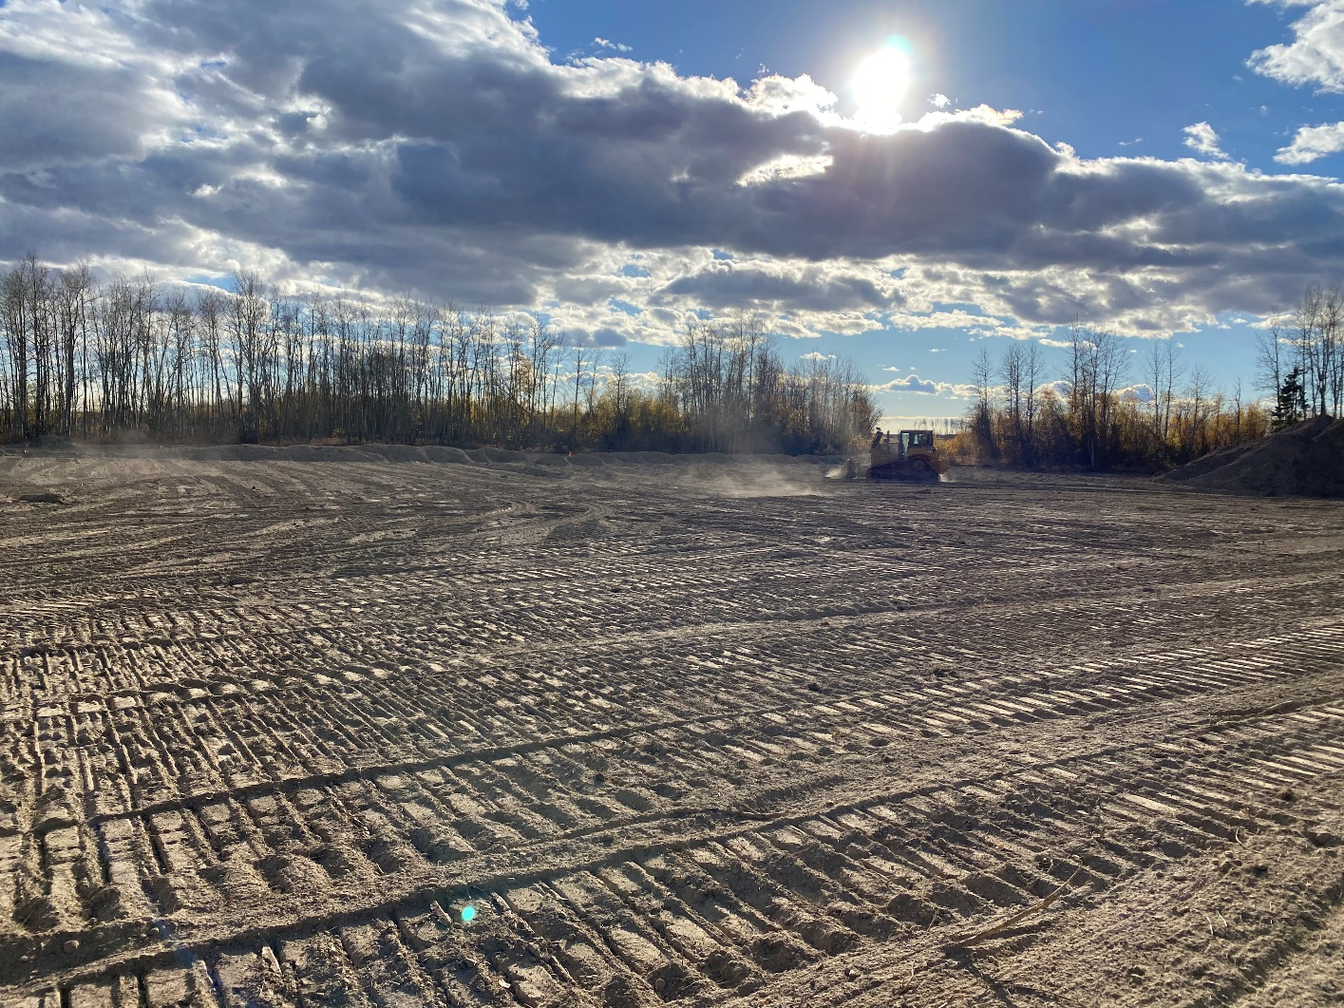
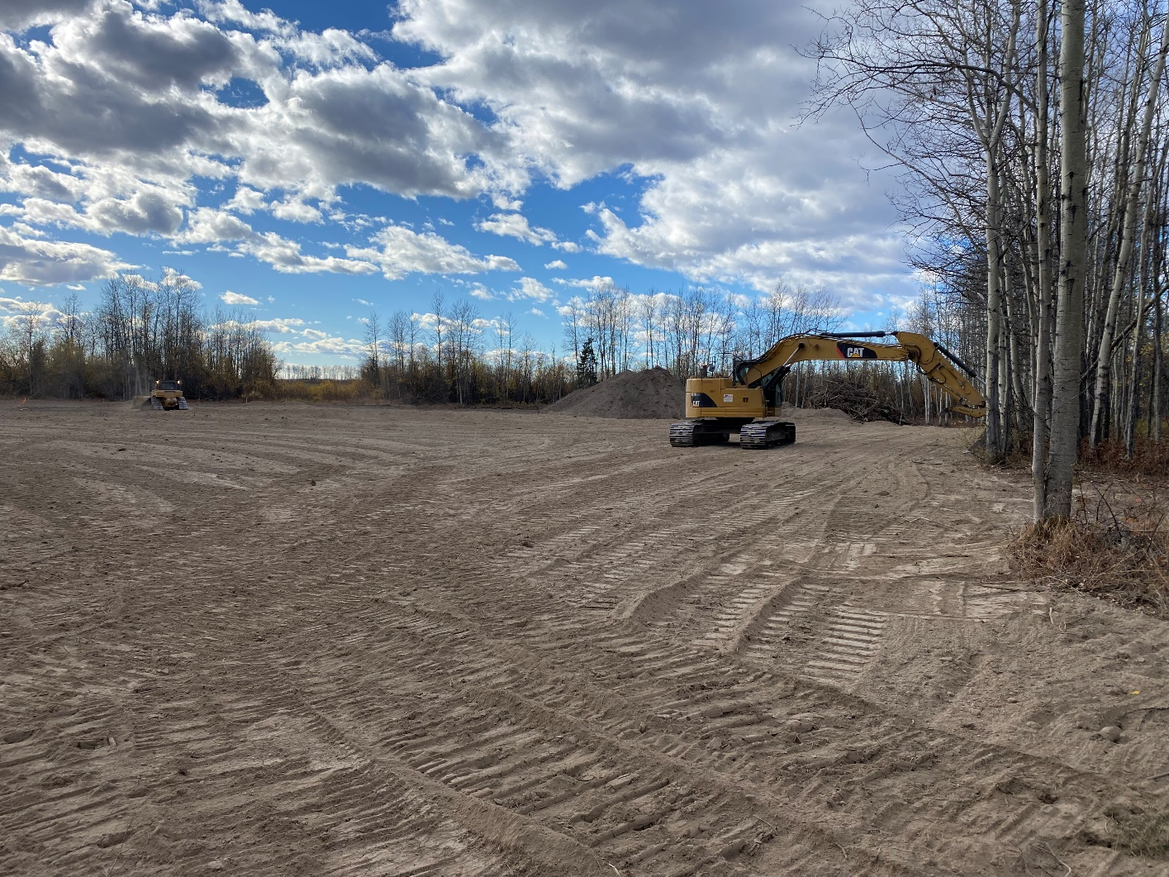
bc-er.ca
17

Slide 18
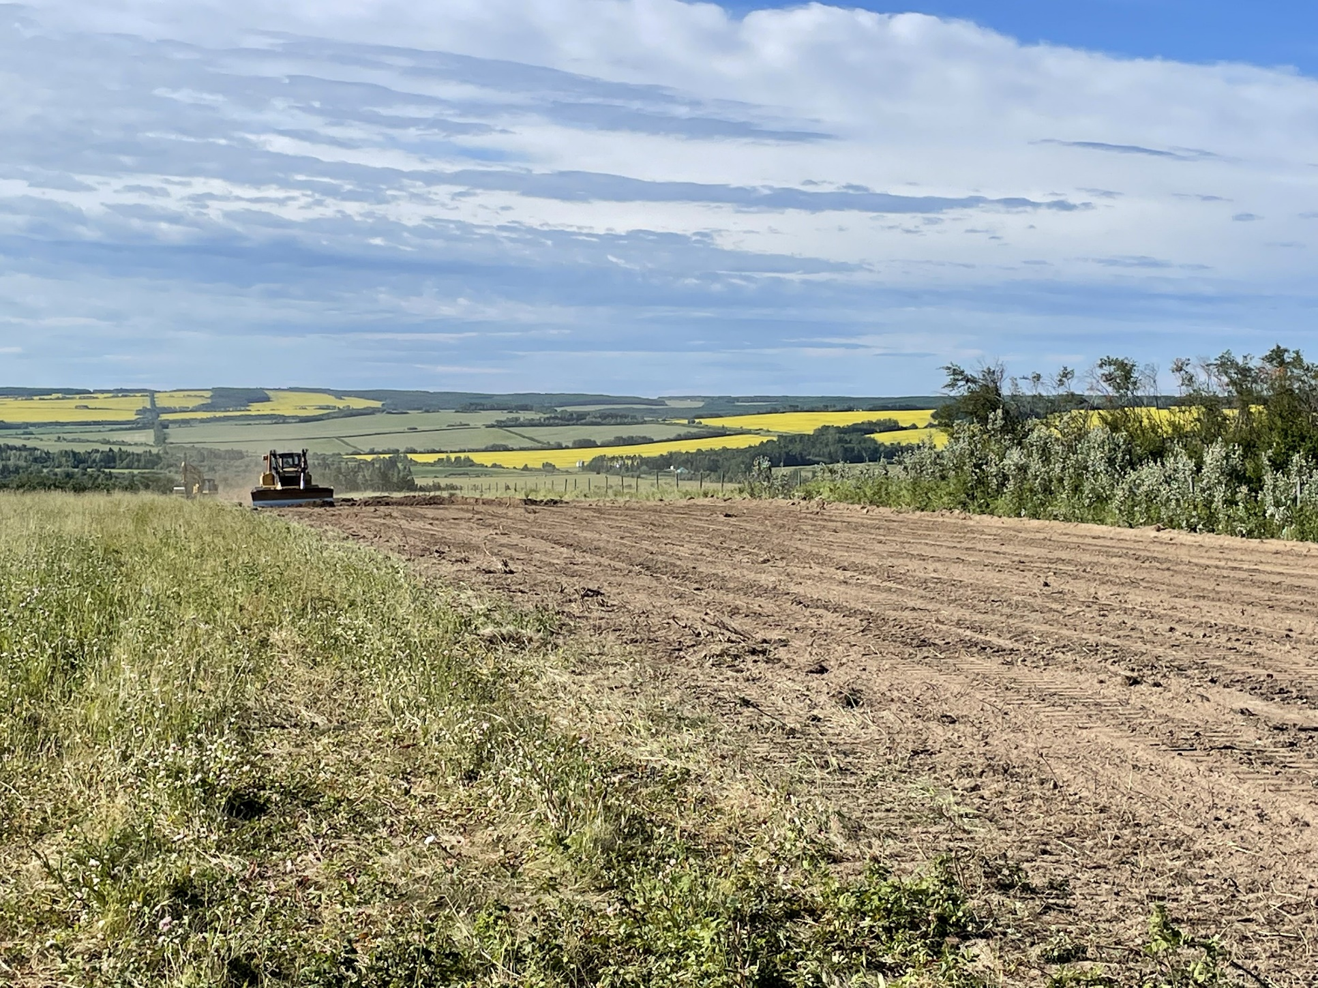
bc-er.ca
18

Slide 19
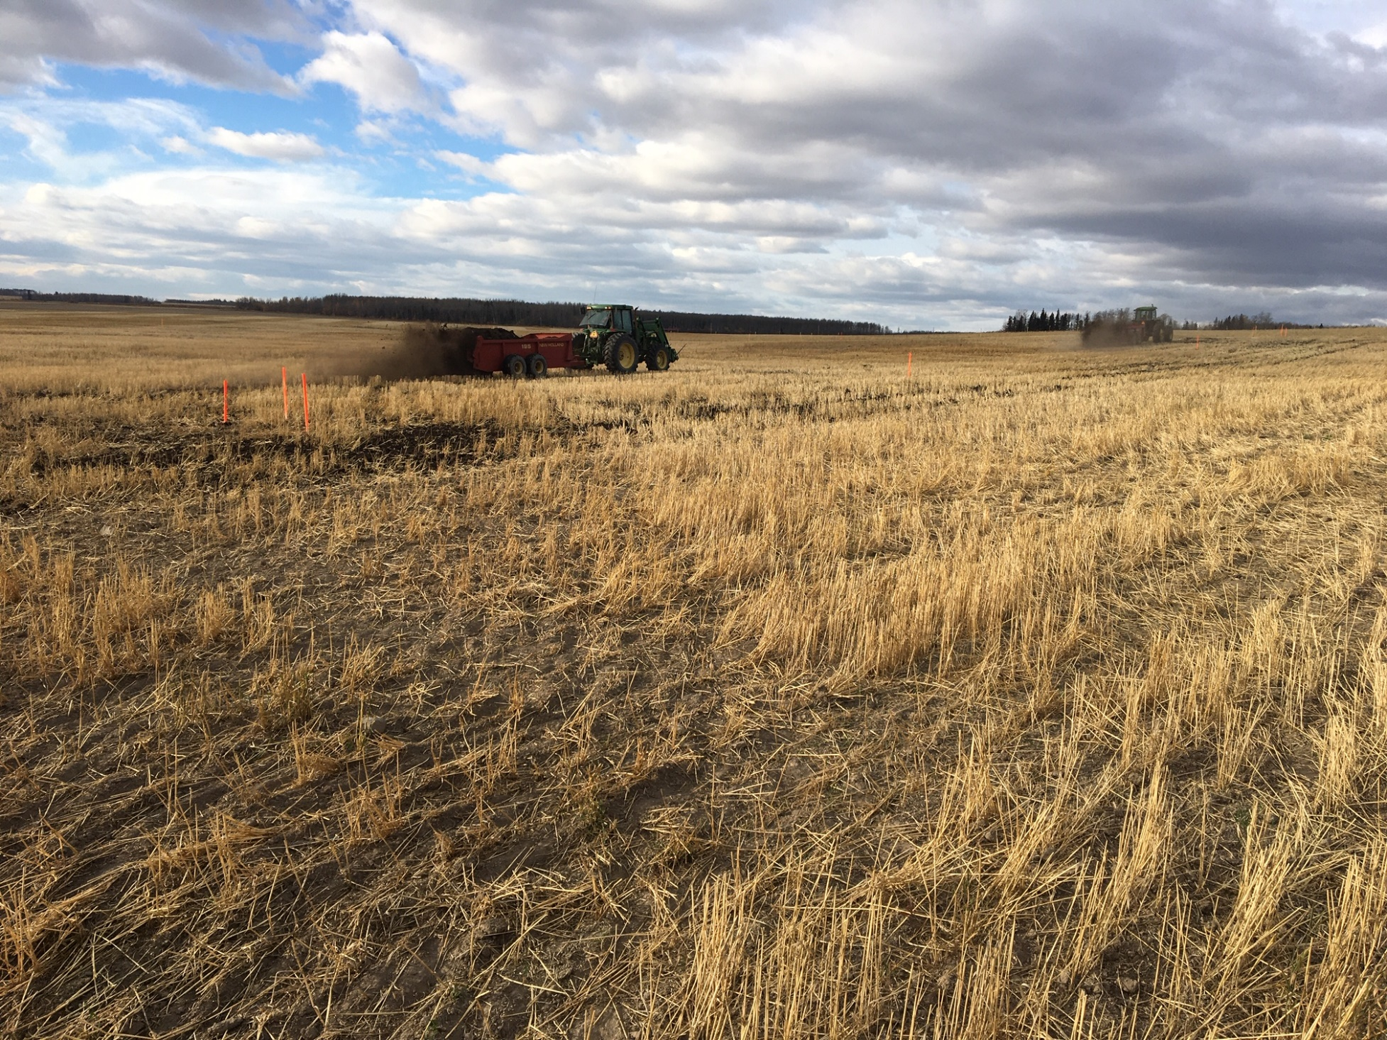
bc-er.ca
19

Slide 20
Recent Work
Over the last year, we carried out our most ambitious work plan to date.
$45 million in levies, surplus funds, and surrendered security was spent on orphan restoration
With the support of northeast B.C. service providers, we completed more than 750 projects on approximately 450 orphan sites
Those numbers again…… ¾ have been decommissioned and ¼ reclaimed
bc-er.ca
20

Slide 21
Upcoming Work
Continue maintenance and weed control programs
Following significant efforts, continue remaining remediation and reclamation in the Peace River Block
Finish remaining decommissioning work in Buick & Fireweed areas, and proceed to investigation and reclamation work
Continue efforts for restoration in the Kotcho Lake area east of Fort Nelson
Final site work to finish reclamation activities in Ladyfern
bc-er.ca
21

Slide 22
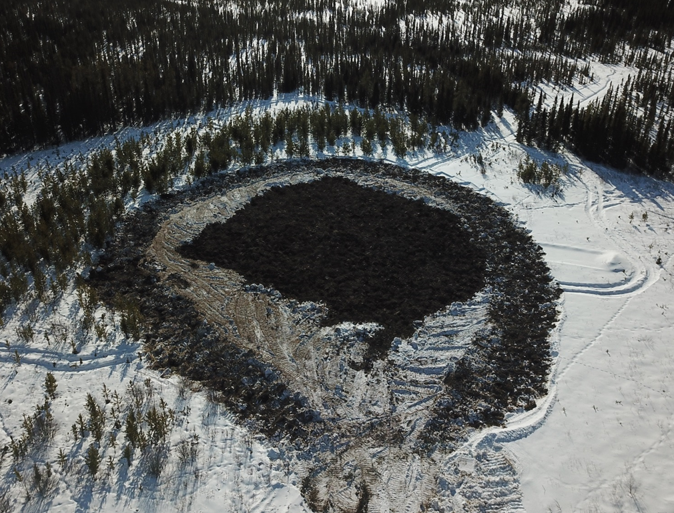
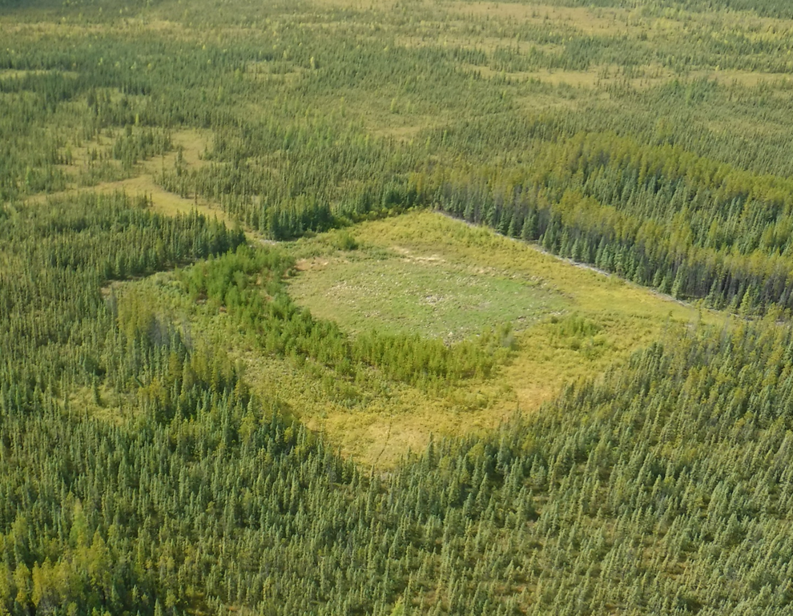
Ladyfern Site
bc-er.ca
22

Slide 23
Questions?
FACEBOOK
TWITTER
LINKEDIN
For more information, please visit: www.bc-er.ca/what-we-regulate/oil-gas/orphan-sites/
INSTAGRAM
Questions can be directed to
orphanrestoration@bc-er.ca
YOUTUBE
Notes:
If you’re done adding content to your slides, don’t forget to:
Take a break! Come back to it with fresh eyes before editing.
Practice presenting to a colleague for constructive criticism and insights.
Visit the full PowerPoint Toolkit at ‘K:\Commission Shared\PowerPoint Toolkit’ to learn how to edit and refine your slides, and to view the video providing tips on how to best present to your audience.

