Slide 1
ERAA and HCA Permitting Transition Guidance
Presented by: Megan Charters
Date: May 27, 2024
Questions? ArchaeologyDL@bc-er.ca

Slide 2
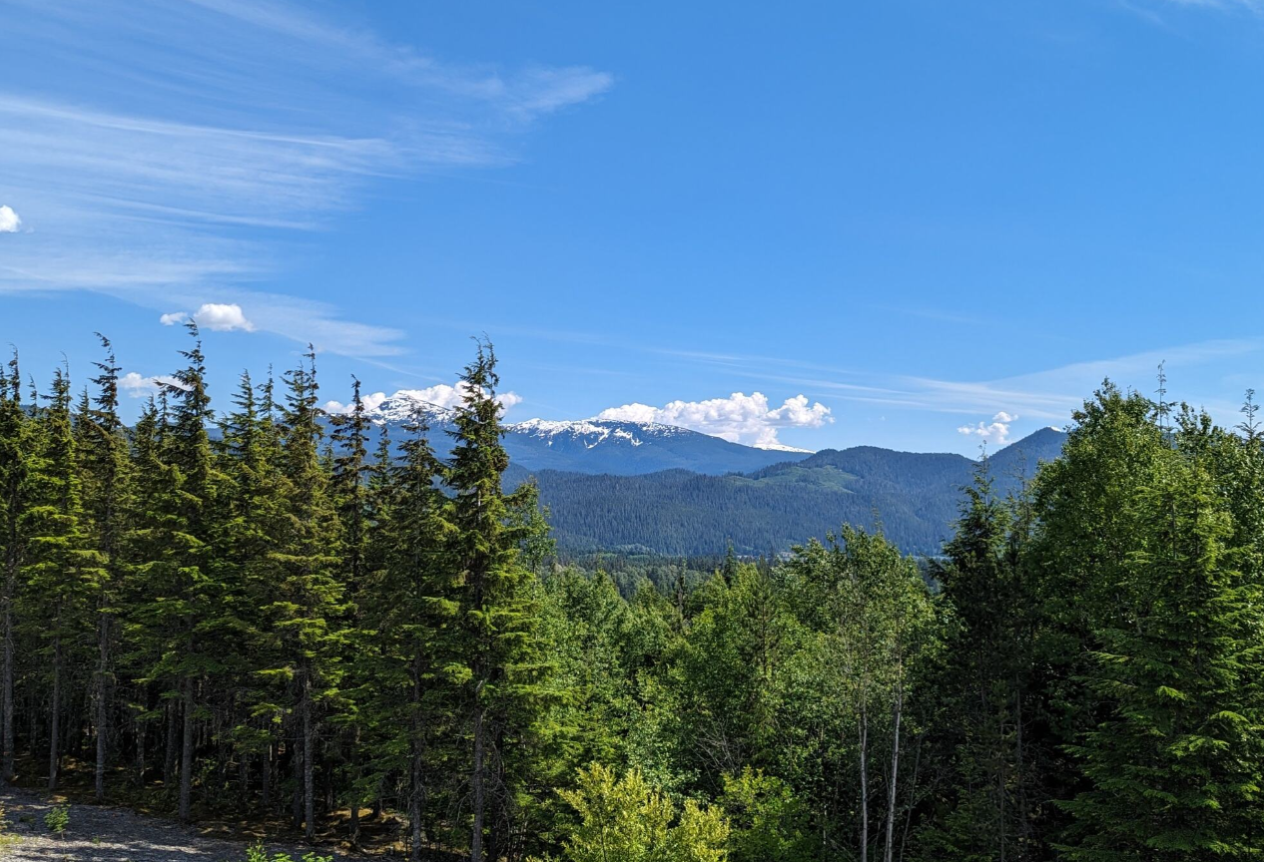
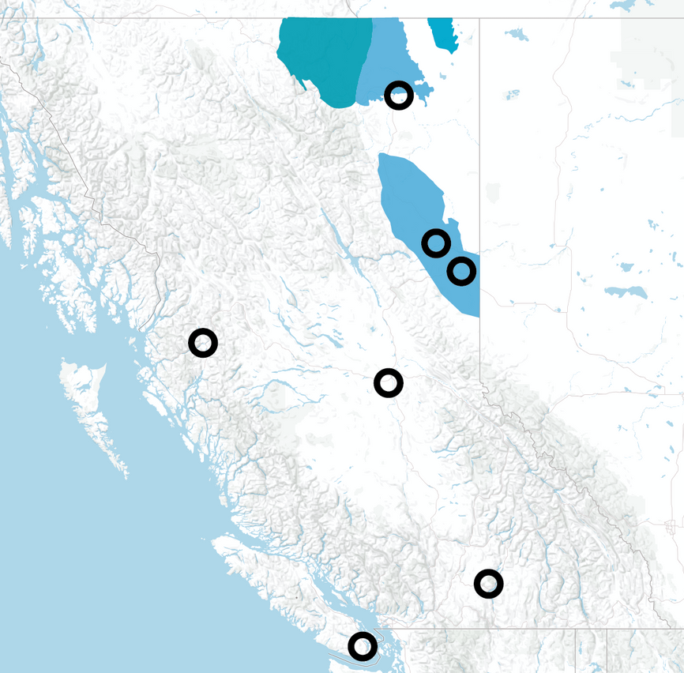
BCER Office Locations Throughout B.C.
Horn River Basin
Cordova Embayment
Liard Basin
Fort Nelson
Montney
Fort St. John
Terrace
Dawson Creek
Prince George
We acknowledge and respect the many First Nations, each with unique cultures, languages, legal traditions and relationships to the land and water, on whose territories the British Columbia Energy Regulator’s work spans.
Kelowna
Victoria
Notes:
We acknowledge and respect the many First Nations, each with unique cultures, languages, legal traditions and relationships to the land and water, on whose territories the British Columbia Energy Regulator’s work spans.

Slide 3
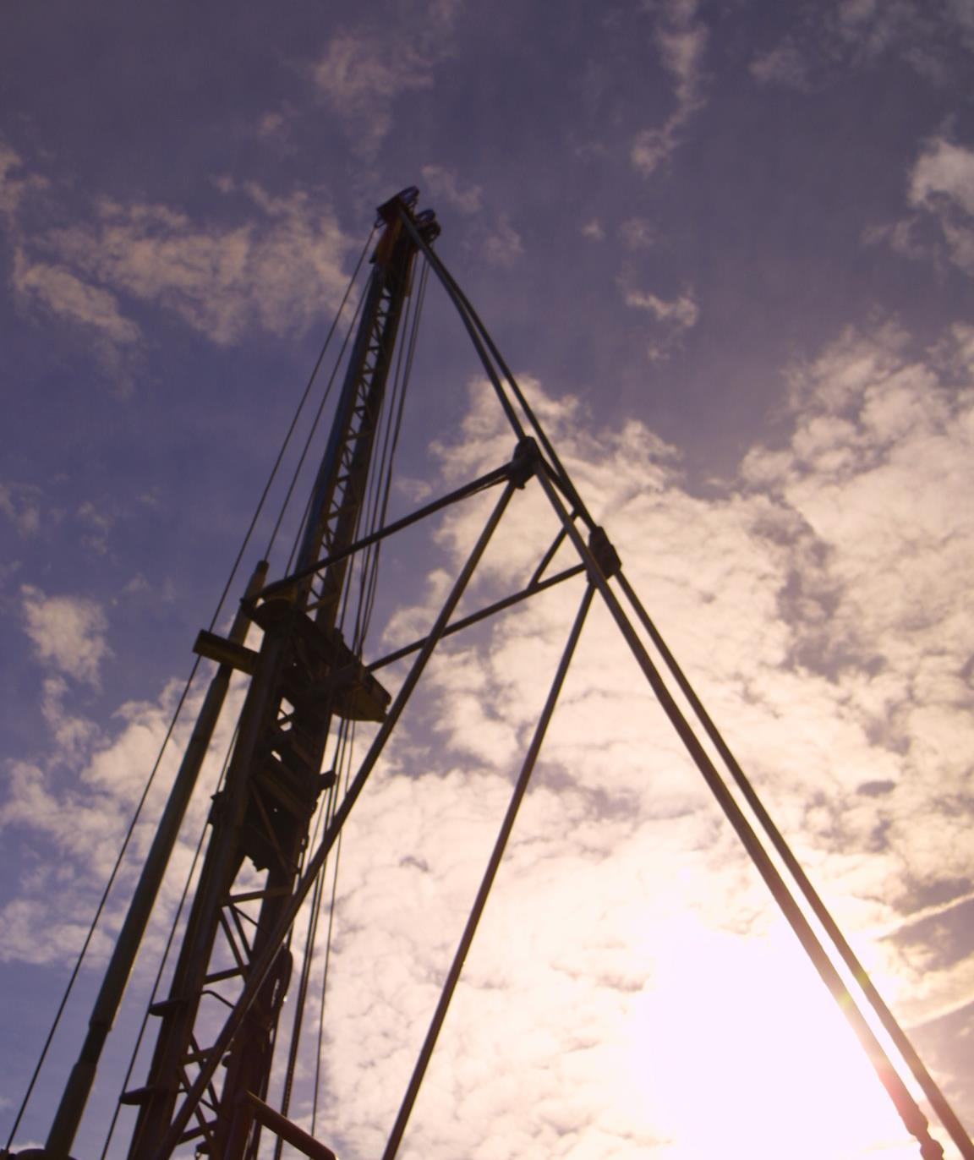
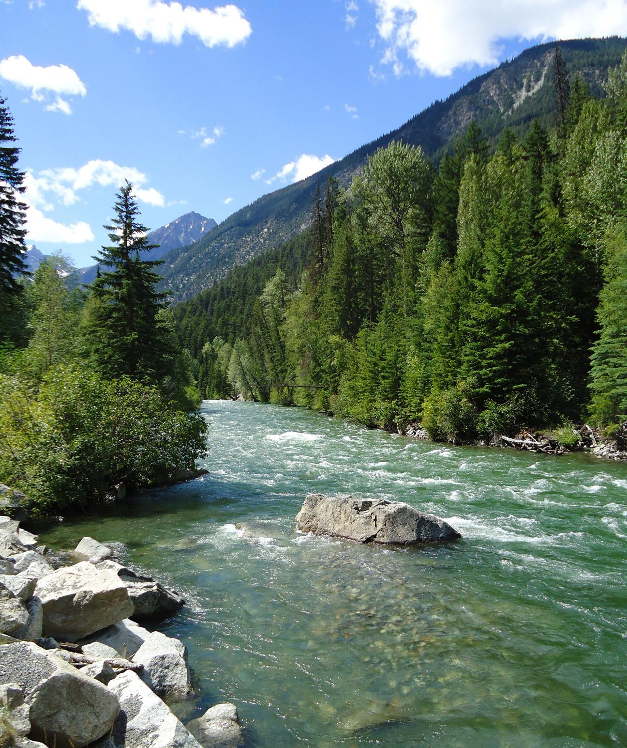
Agenda
01
BCER’s Heritage Conservation Program
02
Transition Plan Update
03
Projects and Permits Impacted
04
Transition Guidance for Active s12.2 Permits

Slide 4
Role of the BC Energy Regulator
Formed in 1998
Regulatory responsibility delegated through Energy Resource Activities Act (formally OGAA)
Regulate full life cycle of energy resource activities in B.C. from site planning to restoration
Accountable to the provincial legislature and the public through the Ministry of Energy, Mines, and Low-Carbon Innovation (EMLI)
Offices across the province: Fort St John, Fort Nelson, Dawson Creek, Terrace, Prince George, Victoria and Kelowna
Subject matter expertise – Hydrologists, Geologists, Engineers, Natural Resource Officers, Emergency Management Officers, Air Specialists, First Nation Liaison Officers
Formed in 1998​
Regulatory responsibility delegated through Energy Resource Activities Act (formally OGAA)​
Regulate full life cycle of energy resource activities in B.C. from site planning to restoration​
Accountable to the provincial legislature and the public through the Ministry of Energy, Mines, and Low-Carbon Innovation (EMLI)​
Offices across the province: Fort St John, Fort Nelson, Dawson Creek, Terrace, Prince George, Victoria and Kelowna​
Subject matter expertise – Hydrologists, Geologists, Engineers, Natural Resource Officers, Emergency Management Officers, Air Specialists, First Nation Liaison Officers

Slide 5
Role of the BC Energy Regulator
ERAA specifies scope of BC Energy Regulator​
Project types regulated by the BCER:​
Pipelines over 700kPa​
Oil and gas well sites, pipelines, ancillaries​
Aspects of geothermal​
Environmental Assessment Office (EAO) projects​
HCA Specified enactments in ERAA do NOT apply to Canada Energy Regulator (CER) pipelines
Formed in 1998​
Regulatory responsibility delegated through Energy Resource Activities Act (formally OGAA)​
Regulate full life cycle of energy resource activities in B.C. from site planning to restoration​
Accountable to the provincial legislature and the public through the Ministry of Energy, Mines, and Low-Carbon Innovation (EMLI)​
Offices across the province: Fort St John, Fort Nelson, Dawson Creek, Terrace, Prince George, Victoria and Kelowna​
Subject matter expertise – Hydrologists, Geologists, Engineers, Natural Resource Officers, Emergency Management Officers, Air Specialists, First Nation Liaison Officers

Slide 6
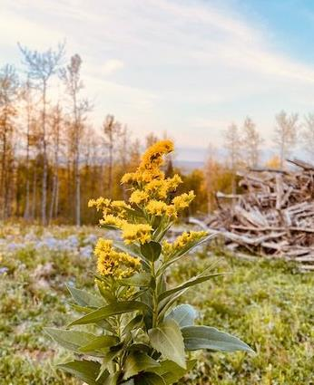
Heritage Conservation Program at the BCER
Since 1999, specified enactment for s12.4 permits
Since 2004, administer northeast B.C. oil and gas multi-assessment section 12.2 permits
Review archaeology component of energy resource applications to BCER
Provide subject matter expertise and recommend permit conditions to ERAA decision makers
Conduct field inspections:
First Nation request or concerns
Landowner and other stakeholder request
Public education
Review archaeological site mitigation techniques
Review s12.4 applications
Compliance assessment for ERAA permits and HCA s12.2 and s12.4 permits
6

Slide 7
Heritage Conservation Program at the BCER
Professional-reliance, performance-based approach
Separate First Nation consultation staff for ERAA and HCA permit applications
Timelines – consistent with ERAA applications
Requirement for pre-engagement
Administrative differences – to be addressed in forthcoming external guidance for proponents and archaeologists
Active communication and partnership with Archaeology Branch
Community of Practice
How do we differ from the Archaeology Branch?​
​
Professional-reliance, performance-based approach​
Separate First Nation consultation staff for ERAA and HCA permit applications​
Timelines – consistent with ERAA applications​
Requirement for pre-engagement​
Administrative differences – to be addressed in forthcoming external manual for proponents and archaeologists​
Active communication and partnership with Archaeology Branch​
Community of Practice
7

Slide 8
:HCA Section 12.2 Transition
Documentation and guidance being developed to support applicants and permit management.
Permit template for s12.2 being developed
Permit template for s12.4 being updated
Updated AIFs for geophysical and non-geophysical applications being updated
Letters for specific permits being subject to legislative amendment
The Archaeology Branch and BCER will continue to work together to support a smooth transition over the upcoming months
8

Slide 9
:HCA Section 12.2 Transition
After June 1, 2024 all communications for transitioned HCA s12.2 permits must be sent to the BCER. To ensure an effective transition archaeologists and proponents must not upload or utilize APTS unless directed by BCER staff.
Any questions can be sent to ArchaeologyDL@bc-er.ca – please include the relevant HCA permit number and associated ERAA numbers if available.
9

Slide 10
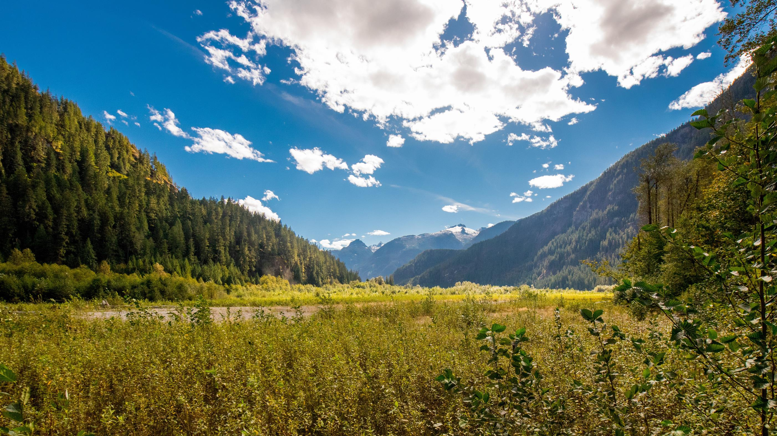
There are four main project types that interact with the BCER and HCA:
Project Type | Description | On June 1, 2024 - Subject to BCER specified enactment for HCA s12.2 in addition to current s12.4
CER Projects | Energy resource projects that are regulated by the Canada Energy Regulator. | The BCER specified enactments do not apply.
EAO Projects | Energy resource projects that are subject to Environmental Assessment Office permitting. | The BCER specified enactments for s12.2 and s12.4 apply.
Northeast BC Projects | Energy resource projects that were subject to Protocol Agreement between Archaeology Branch and BCER (located in NEBC). | The BCER specified enactments for s12.2 and s12.4 apply.
Outside Northeast BC Projects | Energy resource projects that were previously excluded from Protocol Agreement between Archaeology Branch and BCER (not located in NEBC). | The BCER specified enactments for s12.2 and s12.4 apply.

Slide 11
Additional Guidance
Regardless of the project type, archaeologists may complete ERAA application deliverables (AMS and AIFs) to support proponent permit applications
Any submissions of interim reporting to support ERAA application deliverables and/or ERAA permit conditions is distinct and separate from HCA permit requirements and directions

Slide 12
Canada Energy Regulator (CER) s12.2 Permits:
Task/Process | Current Process | After June 1, 2024
S12.2 HCA applications for CER projects | Archaeologist applies to Archaeology Branch | Process remains the same
S12.4 HCA applications for CER projects | Archaeologist applies to Archaeology Branch | Process remains the same
S12.2 Permit Amendments and Extensions | Amendment application to Archaeology Branch | Process remains the same
S12.4 Permit Amendments and Extensions | Amendment application to Archaeology Branch | Process remains the same
Fieldwork Notifications/NOIs | Sent to Archaeology Branch | Process remains the same
Client Certifications | Sent to Archaeology Branch | Process remains the same
Interim reports with no mitigation recommendations/management direction | Sent to Archaeology Branch | Process remains the same
Interim reports with mitigation recommendations/management direction | Sent to Archaeology Branch | Process remains the same
Chance Find Process | Notification to Archaeology Branch | Process remains the same
Questions | Sent to Archaeology Branch Project Officer | Process remains the same
Inventory Decisions, site registration, Borden numbers | Sent to Archaeology Branch inventory | Process remains the same

Slide 13
Environmental Assessment Office (EAO) s12.2 Permits:
Task/Process | Current Process | After June 1, 2024
S12.2 HCA applications for EAO projects subject to BCER regulation | Archaeologist applies to Archaeology Branch | ERAA permit holder applies to BCER - Arch.Submissions@bc-er.ca
S12.4 HCA applications for EAO projects subject to BCER regulation | ERAA permit holder applies to BCER - Arch.Submissions@bc-er.ca | Process remains the same
S12.2 Permit Amendments and Extensions | Amendment application to Archaeology Branch | Amendment application to BCER - Arch.Submissions@bc-er.ca
S12.4 Permit Amendments and Extensions | Amendment application to BCER - Arch.Submissions@bc-er.ca | Process remains the same
Fieldwork Notifications/NOIs | Sent to Archaeology Branch | Send to Arch.Notifications@bc-er.ca
Client Certifications | Sent to Archaeology Branch | Send to Arch.Notifications@bc-er.ca
Interim reports with no mitigation recommendations/management direction | Sent to Archaeology Branch | Send to Arch.Notifications@bc-er.ca
Interim reports with mitigation recommendations/management direction | Sent to Archaeology Branch | Send to Arch.Submissions@bc-er.ca
Chance Find Process | Notification to Archaeology Branch | Notification to BCER: ArchaeologyDL@bc-er.ca / 1-250-794-5200
Questions | Sent to Archaeology Branch Project Officer | Send to ArchaeologyDL@bc-er.ca; please include HCA permit number in subject line and applicable application ERAA application/permit number
Inventory Decisions, site registration, Borden numbers | Sent to Archaeology Branch inventory | Process remains the same

Slide 14
Energy Resource Activities within Northeast BC – subject to Archaeology Branch/BCER Protocol Agreement:
Task/Process | Current Process | After June 1, 2024
S12.2 HCA applications for energy resource activities within the northeast | Archaeologist applies to Archaeology Branch, would be administered by BCER | ERAA permit holder applies to BCER - Arch.Submissions@bc-er.ca
S12.4 HCA applications for energy resource activities within the northeast | ERAA permit holder applies to BCER - Arch.Submissions@bc-er.ca | Process remains the same
S12.2 Permit Amendments and Extensions | Amendment application to Archaeology Branch | Amendment application to BCER - Arch.Submissions@bc-er.ca
S12.4 Permit Amendments and Extensions | Amendment application to BCER - Arch.Submissions@bc-er.ca | Process remains the same
Fieldwork Notifications | Sent to Arch.Notifications@bc-er.ca | Process remains the same
Client Certifications | Sent to Archaeology Branch and BCER | Send all client certifications to Arch.Notifications@bc-er.ca
Interim reports with no mitigation recommendations/management direction | Sent to Arch.Notifications@bc-er.ca | Process remains the same
Interim reports with mitigation recommendations/management direction | Sent to Arch.Submissions@bc-er.ca | Process remains the same
Chance Find Process | Notification to BCER: ArchaeologyDL@bc-er.ca / 1-250-794-5200 | Process remains the same
Questions | Sent to BCER – ArchaeologyDL@bc-er.ca; please include HCA permit number in subject line and applicable application ERAA application/permit number | Process remains the same
Inventory Decisions, site registration, Borden numbers | Sent to Archaeology Branch inventory | Process remains the same

Slide 15
Energy Resource Activities not subject to Archaeology Branch/BCER Protocol (ex. transmission pipelines, BCER regulated projects outside northeast BC)
Task/Process | Current Process | After June 1, 2024
S12.2 HCA applications for energy resource activities within remainder of province | Archaeologist applies to Archaeology Branch | ERAA permit holder applies to BCER - Arch.Submissions@bc-er.ca
S12.4 HCA applications for energy resource activities within remainder of province | ERAA permit holder applies to BCER - Arch.Submissions@bc-er.ca | Process remains the same
S12.2 Permit Amendments and Extensions | Amendment application to Archaeology Branch | Amendment application to BCER - Arch.Submissions@bc-er.ca
S12.4 Permit Amendments and Extensions | Amendment application to BCER - Arch.Submissions@bc-er.ca | Process remains the same
Fieldwork Notifications/NOIs | Sent to Archaeology Branch | Send to Arch.Notifications@bc-er.ca
Client Certifications | Sent to Archaeology Branch | Send all client certifications to Arch.Notifications@bc-er.ca
Interim reports with no mitigation recommendations/management direction | Sent to Archaeology Branch | Send to Arch.Notifications@bc-er.ca
Interim reports with mitigation recommendations/management direction | Sent to Archaeology Branch | Send to Arch.Submissions@bc-er.ca
Chance Find Process | Notification to Archaeology Branch or BCER (if BCER administered permit) | Notification to BCER: ArchaeologyDL@bc-er.ca / 1-250-794-5200
Questions | Sent to Archaeology Branch Project Officer | Send to ArchaeologyDL@bc-er.ca; please include HCA permit number in subject line and applicable application ERAA application/permit number
Inventory Decisions, site registration, Borden numbers | Sent to Archaeology Branch inventory | Process remains the same

Slide 16
Permit Support
On June 1st, any additions of field directors to transferred s12.2 permits must be sent to ArchaeologyDL@bc-er.ca
If you have outstanding questions, field director additions, reporting etc., after June 1st, please forward onto ArchaeologyDL@bc-er.ca
Available for permit specific meetings to ensure all information is up-to-date

Slide 17
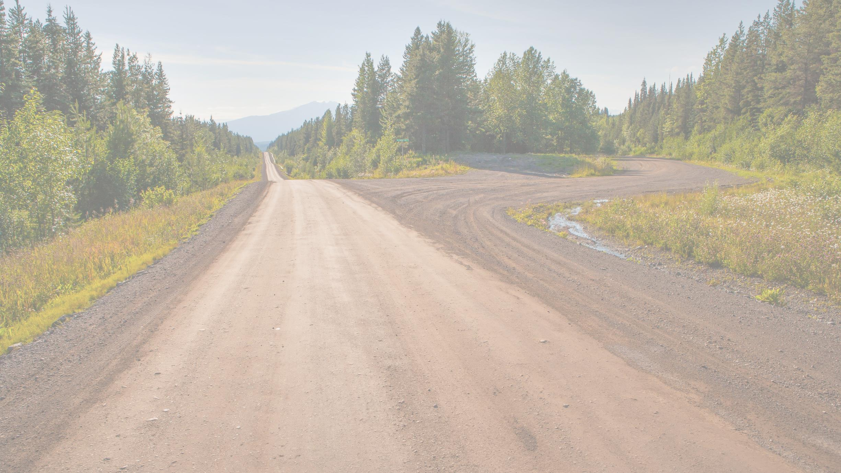
Thank you!
Questions? Contact us! ArchaeologyDL@bc-er.ca

